Slide 1


INSPIRE | EQUIP | CONNECT |

Slide 2
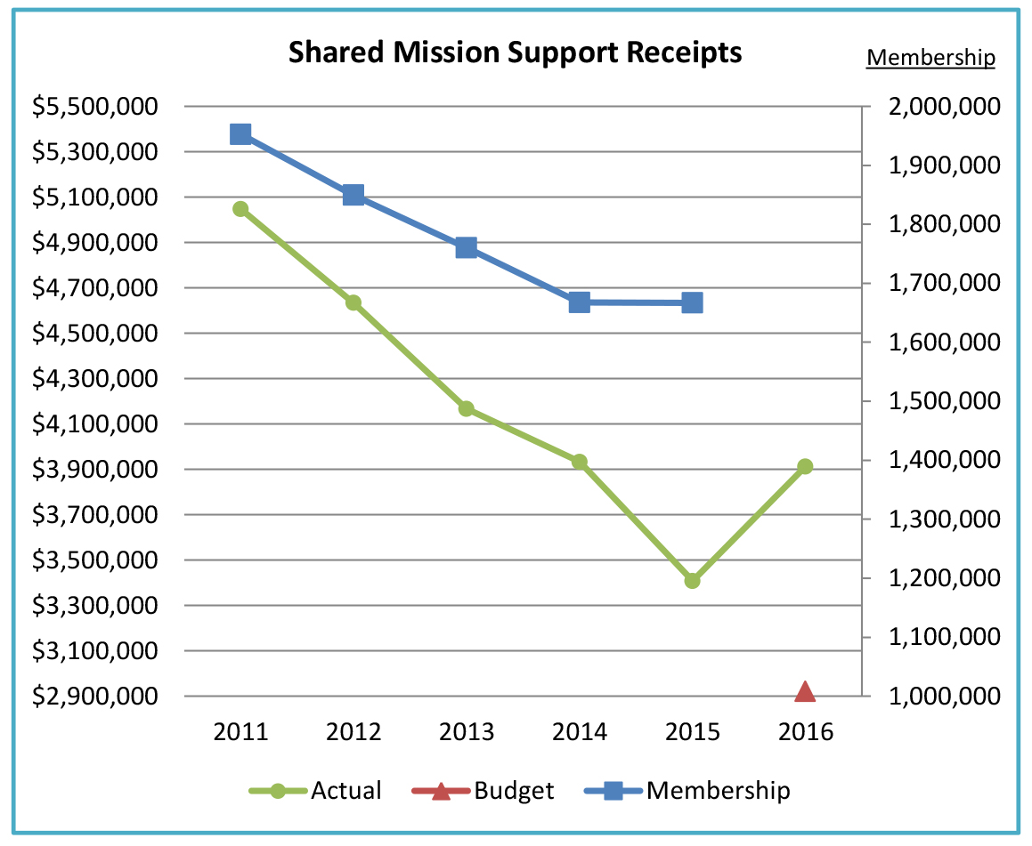

Slide 3
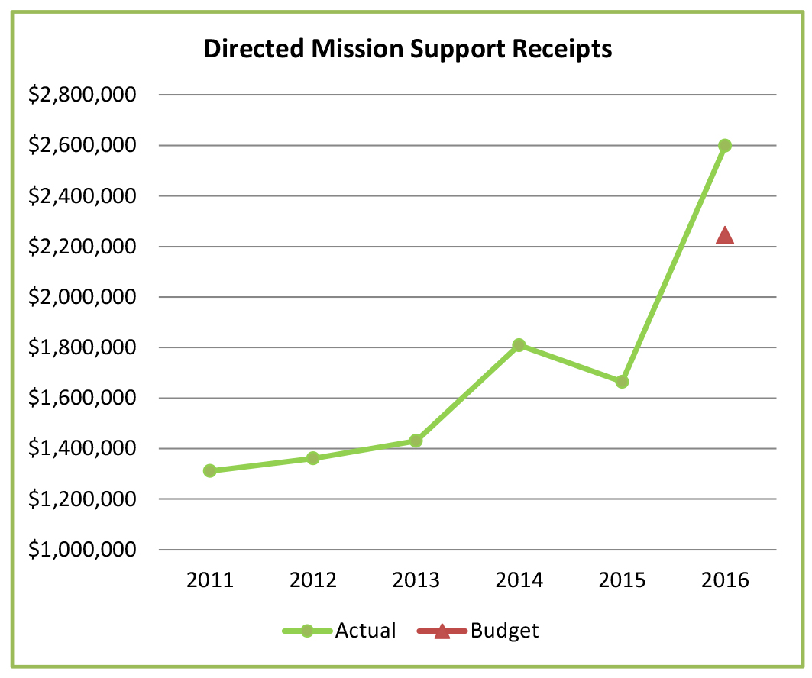

Slide 4
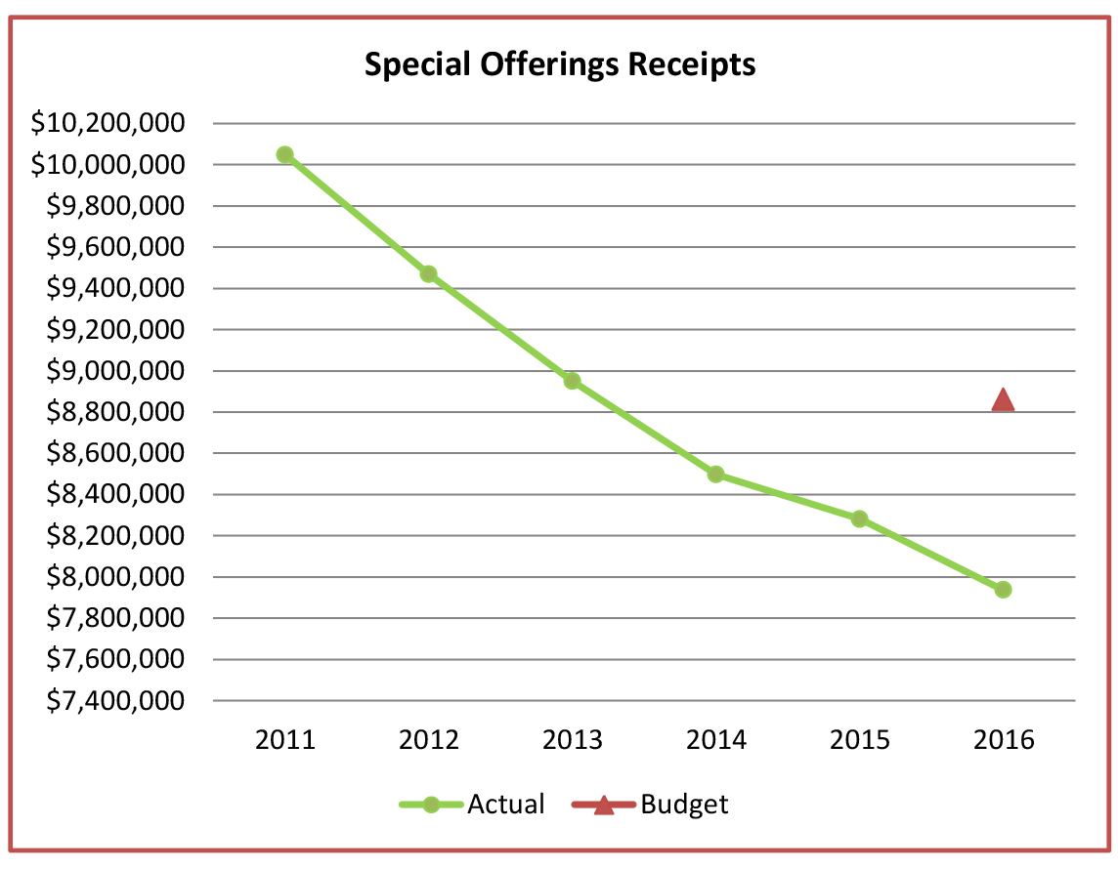

Slide 5
1,138 or 22% not remitting

Slide 6
2,610 or 32% not remitting

Slide 7
881 or 27% not remitting

Slide 8
455 or 18% not remitting

