Slide 1
Mission Engagement and Support
Inform, Interpret, Engage
For Generous Giving
Mid Council Financial Network
November 2016

Slide 2
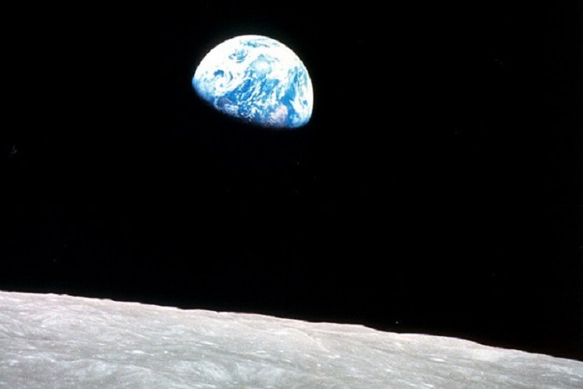
The Lens of Stewardship:
Answering “Why?”
The earth is the Lord’s and all that is in it, the world, and those who live in it; for God has founded it on the seas, and established it on the rivers.
Psalm 24:1-2 (NRSV)

Slide 3
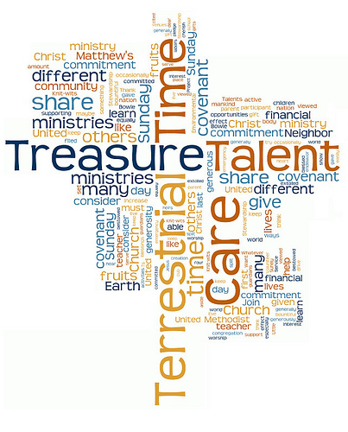
The Lens of Stewardship: Answering “Why?”
¹Think of us in this way, as servants of Christ and stewards of God’s mysteries. ²Moreover, it is required of stewards that they should be found trustworthy.
1 Corinthians 4:1-2, NRSV

Slide 4

The Lens of Stewardship: Answering “What?”
Stewardship is everything you do after you say, “I Believe”.

Slide 5
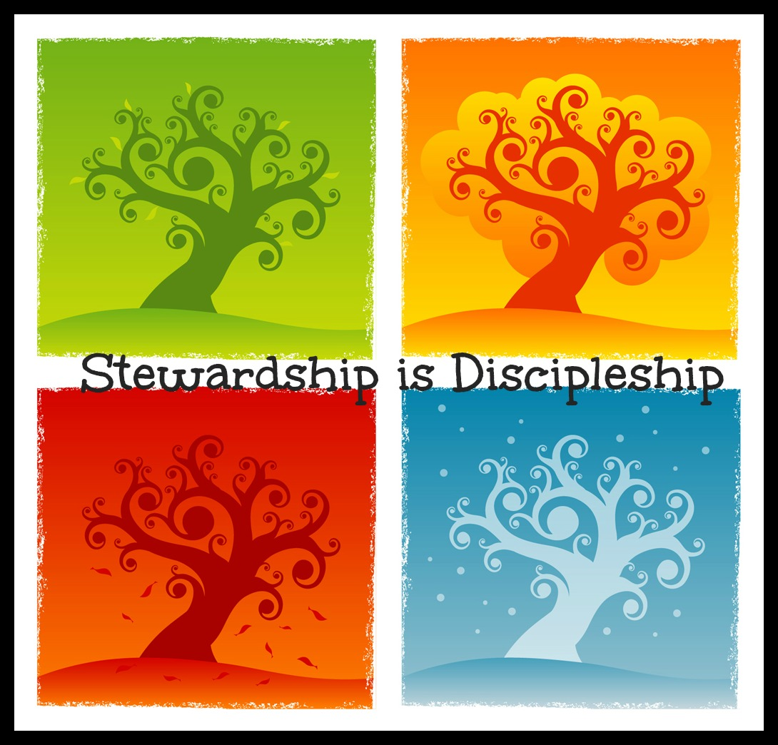
Presbyterian Mission
Stewardship is Discipleship

Slide 6
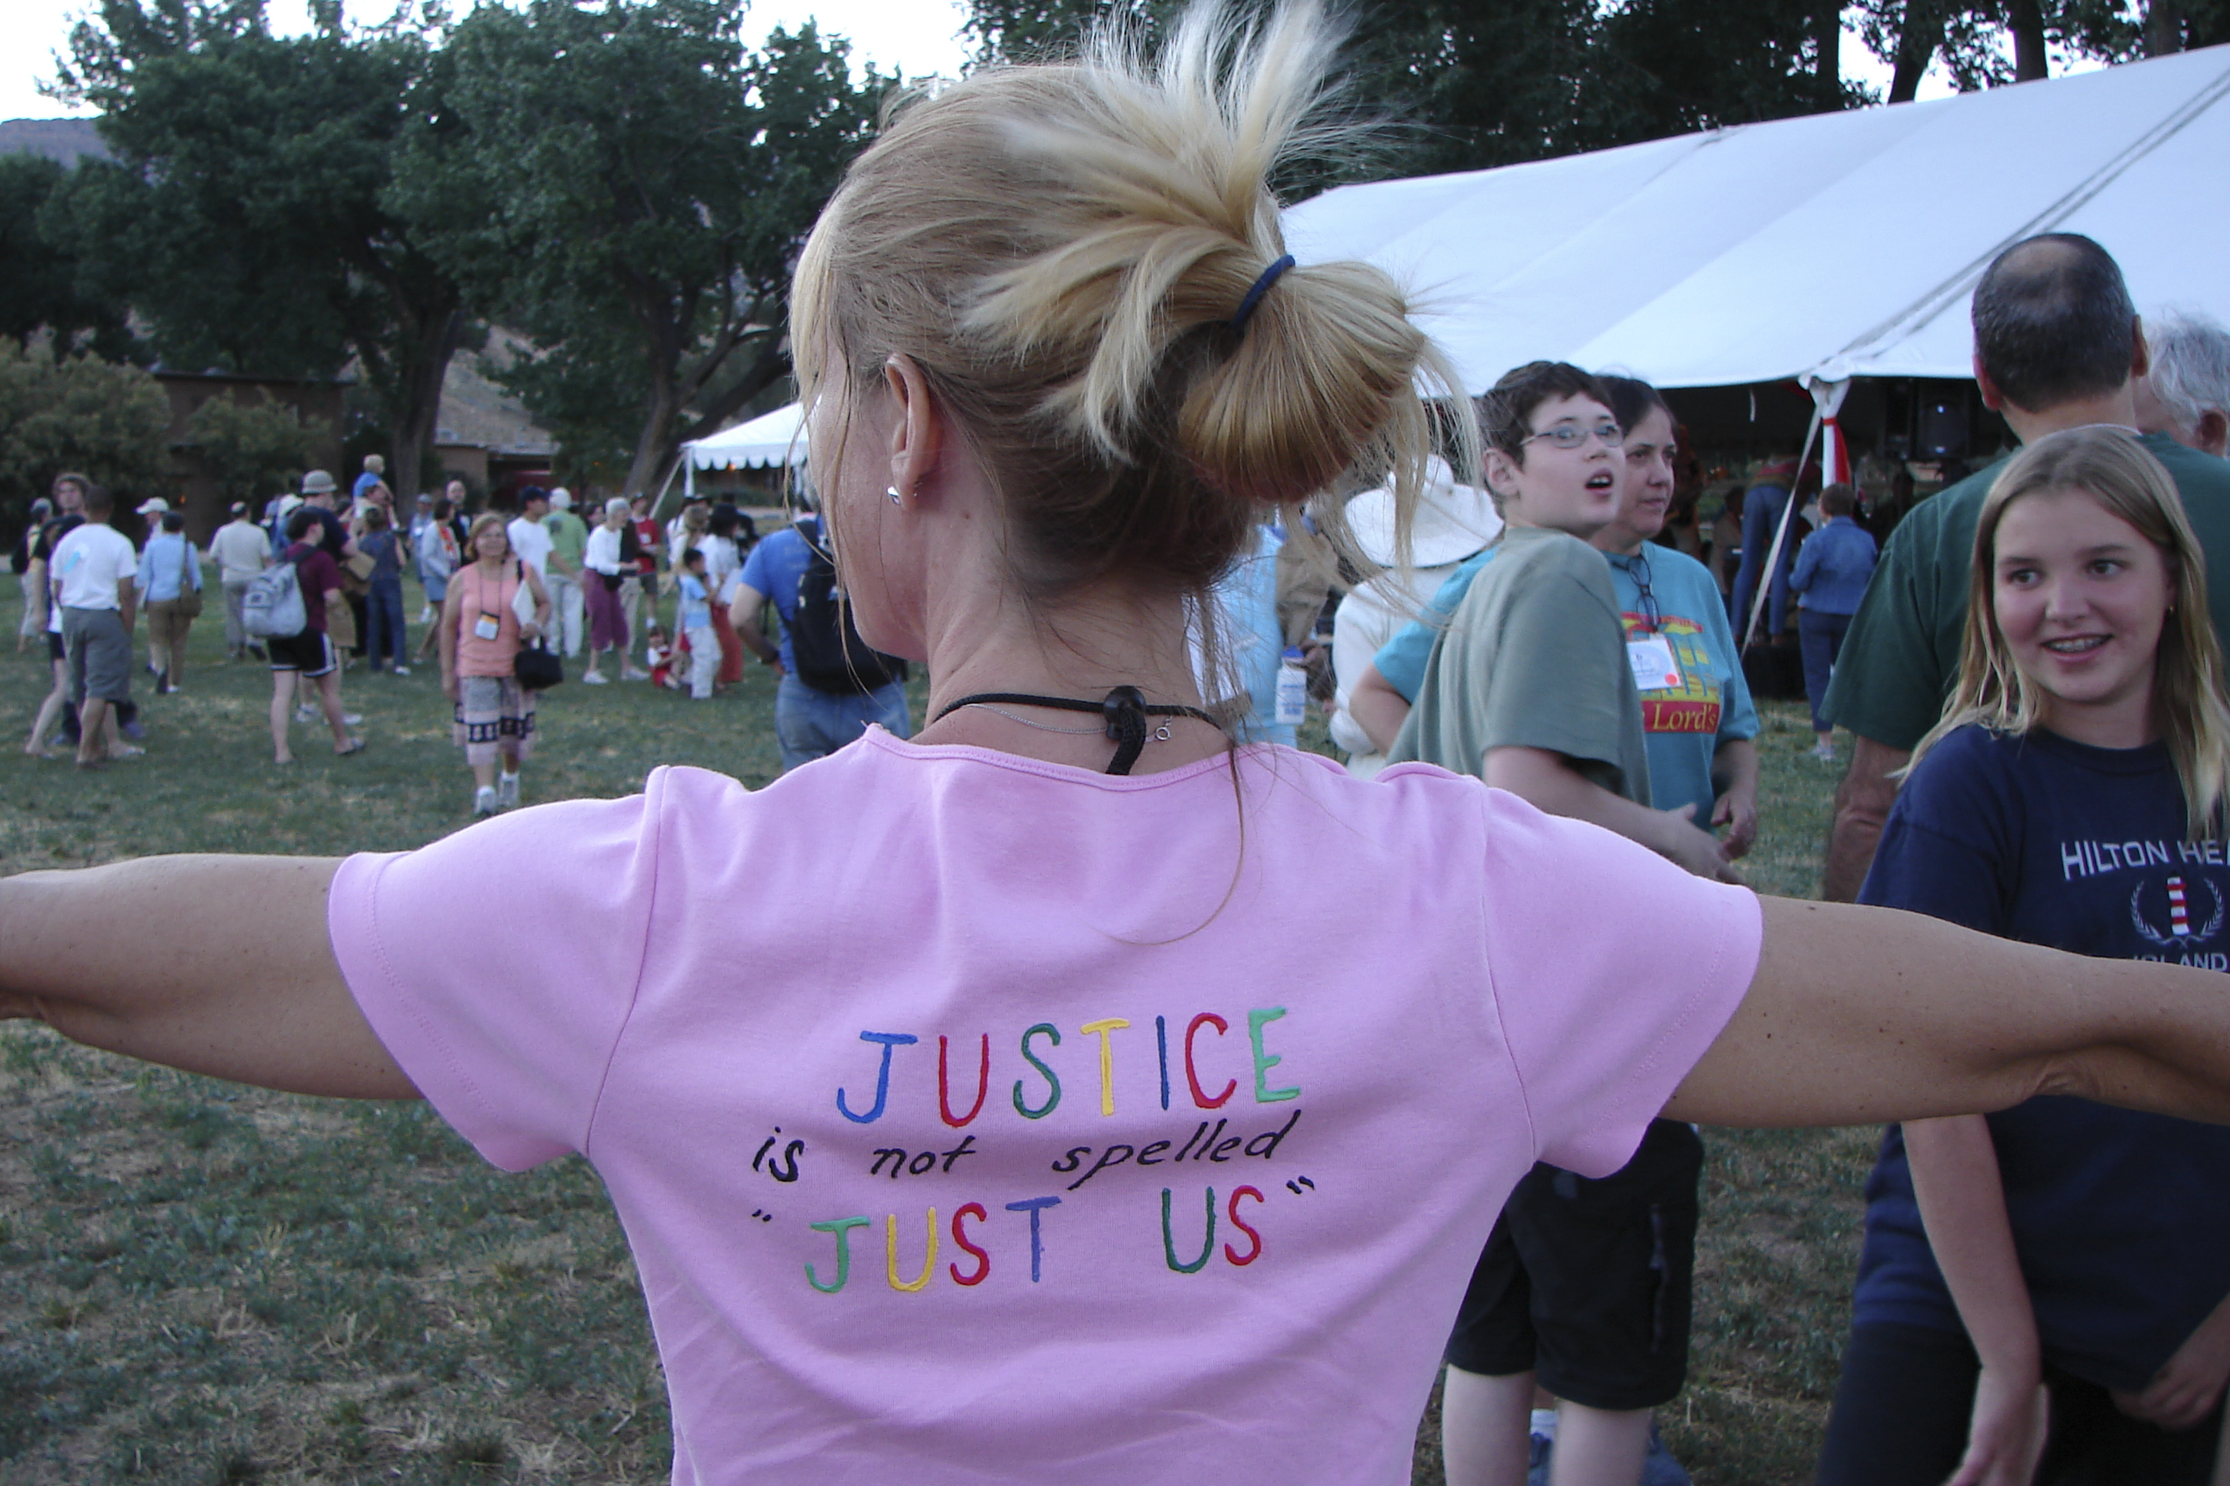
Stewardship = God’s Love in Action

Slide 7

How? Mission Engagement and Support
Inform
Interpret
Engage

Slide 8





How? Special Offerings

Slide 9
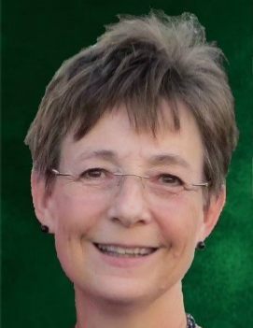
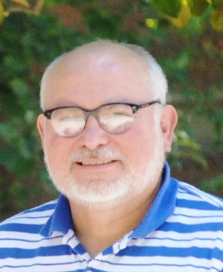
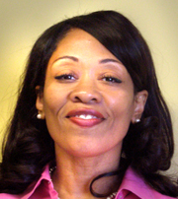
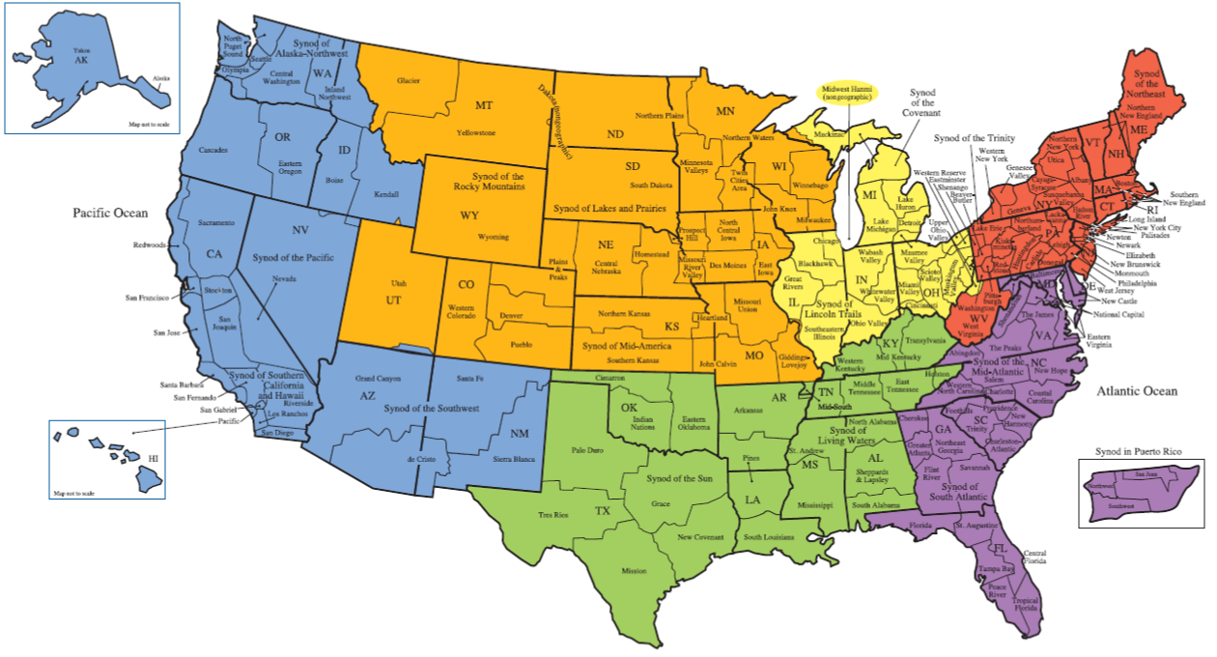
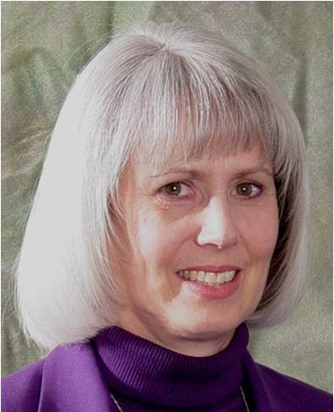
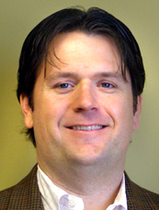
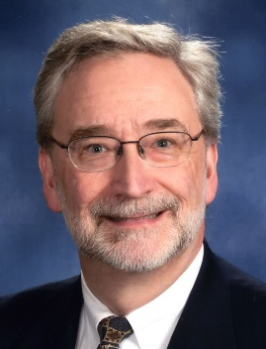
Who? Mission Engagement Advisors
Rhonda Kruse
Synods of the Rocky Mountains, Lakes and Prairies and Mid-America
Chris Roseland
Synods of the Covenant and Lincoln Trails
  Lynne Foreman
  Synods of the Northeast and Trinity
René Myers
Synods of Alaska Northwest, Pacific, Southern California & Hawaii, and Southwest
  Bill McConnell Synods the Sun and Living Waters
Sy Hughes
Synods of Mid-Atlantic, South Atlantic and Boriquén (Puerto Rico)

Slide 10

Who? Relationship and Development Operations
Notes:
Traditional funding sources are declining

Slide 11

Research Services

Slide 12
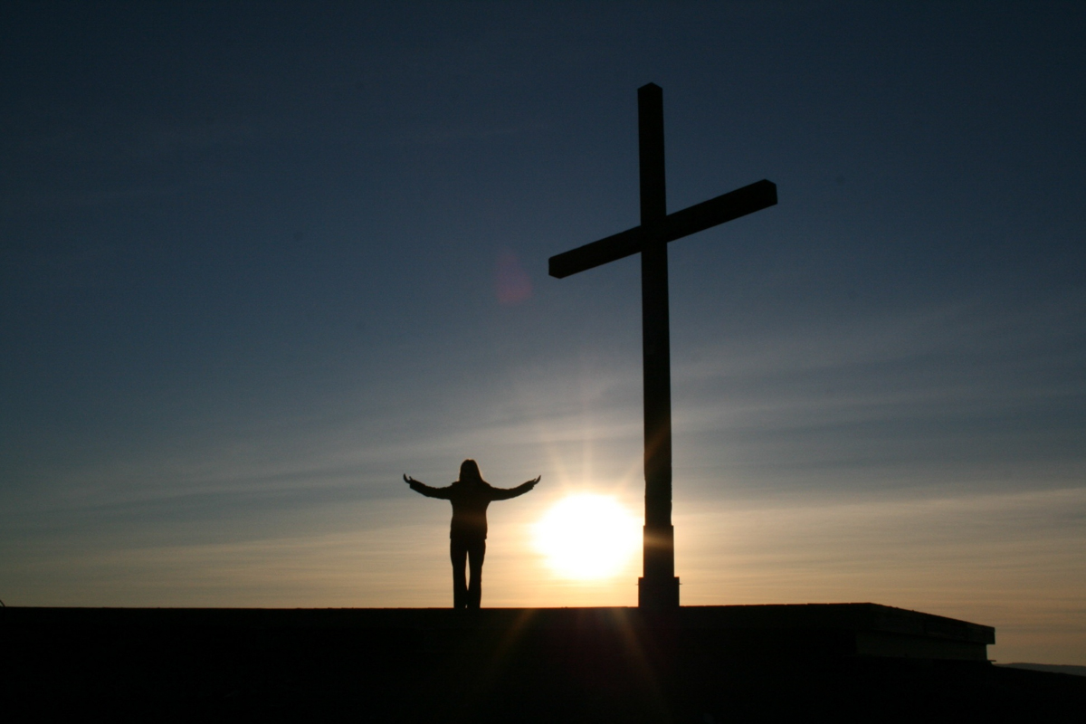
Have you considered…?
Why would God send God’s son to die for me but expect me to just give a little?

Slide 13

Meister Eckhart (c. 1260-1328)
“If the only prayer you say in your life is ‘thank you’ that is enough.”

Slide 14


