Slide 1
Property and Church Dismissals
Mid Council Financial Network
November 16, 2016

Slide 2
Foundations
We are not congregational, independent, or affiliated churches

Slide 3
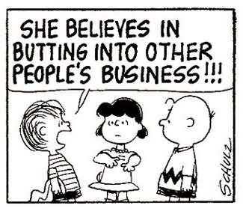

Slide 4
Nature of the Church: One Church
Jesus Christ is the Head of the Church
Particular congregations taken collectively, constitute one church
Congregation is not of itself sufficient form of the church
Bound in communion with one another united in relationships of accountability and responsibility
The fellowship of women, men, and children in covenant relationship with God through Jesus Christ
Not designed to work without trust and love

Slide 5
Governed by the Constitution
Each congregation governed by the Constitution
Members put themselves under the leadership of the session and the higher councils
Councils are united by the nature of the church sharing with one another responsibilities, rights and powers
Councils are distinct but have such mutual relations that the act of one is the act of the whole church
Jurisdiction of each council limited by Constitution, subject to review of the next higher council

Slide 6
Church Property
Property as a Tool for Mission G-4.0201
“The property of the Presbyterian Church (U.S.A.), of its councils and entities, and of its congregations, is a tool for the accomplishment of the mission of Jesus Christ in the world.”
Church Property Held in Trust G-4.0203
“All property held by or for a congregation, a presbytery, a synod, the General Assembly, or the Presbyterian Church (U.S.A.), whether legal title is lodged in a corporation, a trustee or trustees, or an unincorporated association….is held in trust nevertheless for the use and benefit of the Presbyterian Church (U.S.A.).”

Slide 7
Responsibilities of Session
Governing the congregation
Participating in the life of the whole church through participation in other councils
See that the guidance and communication of presbytery, synod and General Assembly are considered and binding actions observed
Welcome representatives of presbytery on occasion of their visits
(Session & PNC) Consider presbytery’s counsel on merits, suitability and availability of those considered for a call

Slide 8
Responsibilities of Presbytery
Government of the church throughout its district
Assisting and supporting the witness of congregations so all congregations become communities of faith, hope, love & witness
Organizing, receiving, merging, dismissing, and dissolving congregations
Exercising pastoral care for congregations and members
Ordaining, receiving, dismissing, installing, removing, and disciplining its members

Slide 9
Responsibilities of Presbytery
Develop strategy for the mission of the church in its district
Promoting peace and harmony of congregations
Inquiring into sources of discord
Counsel with session concerning difficulties
Advising on appropriate action
Offering help as mediator
Acting to correct difficulties
Assume original jurisdiction when session cannot exercise its authority
Consider and act on actions regarding real property

Slide 10
Responsibilities of those in Ordered Ministry
Will you be governed by our church’s polity, and will you abide by its discipline? Will you be a friend among your colleagues in ministry, working with them, subject to the ordering of God’s Word and Spirit?
W-4.4003e.
Do you promise to further the peace, unity, and purity of the church?
W-4.4003g.

Slide 11
Current Context
How did we get here? Where are we now?

Slide 12
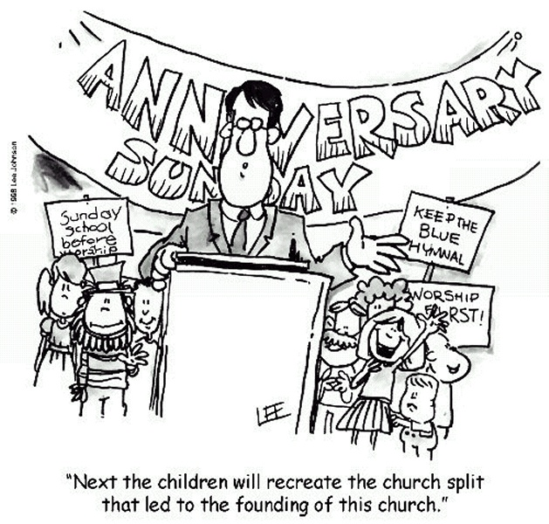

Slide 13
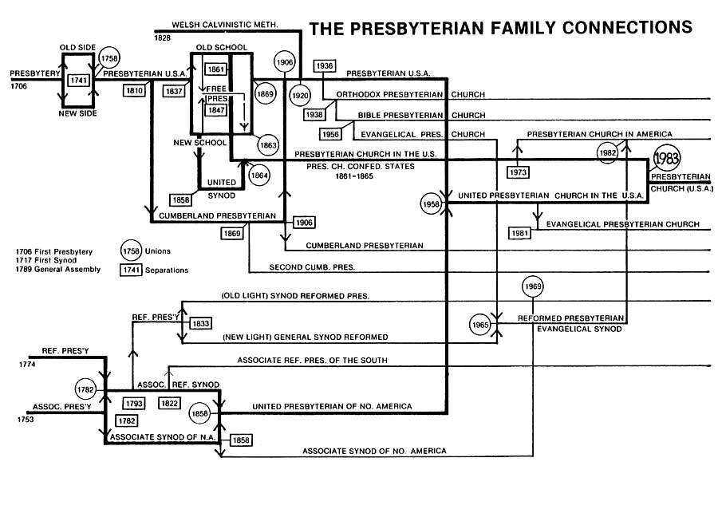

Slide 14
Congregations

Slide 15
Gracious Dismissal
Action of 218th General Assembly (2008)
Develop and implement a process ‘to divide, dismiss, or dissolve churches in consultation with their members’ using the following principles:
Consistency
Pastoral Responsibility
Accountability
Gracious Witness
Openness and Transparency

Slide 16
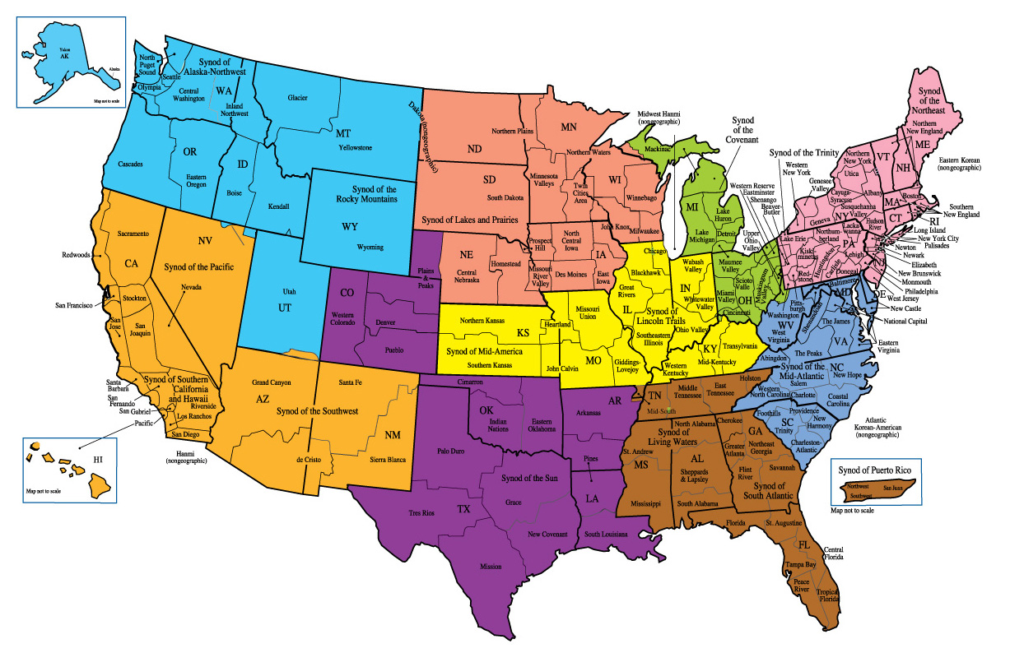

Slide 17
The “Playbook”?
Recruitment/wooing is happening
“The PC(USA) is/does/doesn’t…”
Presbytery hears… The sound of silence
Bylaws, articles of incorporation changed
Letter to Presbytery: “FPC has voted to terminate our voluntary affiliation with the Presbyterian Church (USA)”
Stonewalling
What about the pastor(s)? “I’m still discerning”

Slide 18
Local Context: You shouldn’t be surprised
The history of the congregation
Theological leanings of the congregation
Relationship with the presbytery
When was the last time presbytery showed up?
Pastoral leadership

Slide 19
Discerning Together
Discovering God’s Will

Slide 21
Getting to the Table
Be in a spirit of prayer
Appeal to our connection in Jesus Christ
Christ’s prayer for unity (John 17:11-23)
Christ’s teaching (Matthew 5:21-25a)
Paul’s letters dealing with church conflict (Galatians, Corinthians)
Work together to further the Church of Jesus Christ
Clarify the PC(USA) Polity to which you (and they) are bound
“Will you be governed by our church’s polity, and abide by its discipline? Will you be a friend among your colleagues in ministry, working with them, subject to the ordering of God’s Word and Spirit?” W-4.4003e.

Slide 22
Listen
Be in a spirit of prayer
How will you structure the conversations?
What is being shared with the congregation?
What are the feelings behind the words?
Who is doing the talking?
Who is missing from the conversation? Are there silenced voices?

Slide 23
Providing Information
Be in a spirit of prayer
Find out what the congregation has been told
Share how this personally affects you and Presbytery
Be prepared to dispel any misinformation
Don’t be surprised by, “Don’t confuse me with the facts.”
Can you answer, “Why should they stay?”
How will you get the information out to everyone in the congregation?

Slide 24
Discerning, Reporting & Recommending
Be in a spirit of prayer
Is reconciliation possible? Under what circumstances?
Where should Presbytery go from here?

Slide 25
Presbytery Action
What can and should we do?

Slide 26
Reconciliation
Thanks be to God!
The work of the presbytery is not done
Relationship rebuilding

Slide 27
Dissolution
Only Presbytery can dissolve a congregation
XYZ Presbyterian Church ceases to exist
Presbytery holds the membership rolls
Presbytery directs disposition of property

Slide 28
Dismissal
Only Presbytery can dismiss a congregation
Any vote/survey/conversation with the congregation is advisory to the Presbytery as it discerns
Presbytery determines where a congregation is dismissed
doctrinally consistent with the essentials of Reformed theology as understood by the presbytery;
governed by a polity that is consistent in form and structure with that of the Presbyterian Church (U.S.A);
of sufficient permanence to offer reasonable assurance that the congregation is not being dismissed to de facto independence.
Presbytery determines under what circumstances and terms

Slide 29
GAPJC Dismissal Clarification
Tom v. Presbytery of San Francisco (2012)
Presbytery's authority to determine property rights must be guided by the presbytery acting as a fiduciary for the benefit of the PC(USA).
The fiduciary duty requires presbytery to exercise due diligence as regarding the value of the property of a congregation seeking dismissal.
Due diligence will include not only the spiritual needs of the congregation but an examination of the financial position and the value of the property of the congregation.
Payments for per capita or mission obligations are not satisfactory substitutes for valuations of the property held in trust.

Slide 30
GAPJC Dismissal Clarification
NYC Presbytery v. McGee (2014)
Presbytery has exclusive right and responsibility to dismiss a congregation and is the direct act of the presbytery.
Presbytery cannot have a predetermined, formulaic mechanism for dismissal.
Presbytery has a fiduciary obligation owed to the whole church. As trustee, it must exercise due diligence that its determination is both reasonable and evident.
An appropriately timed, individual, and unique determination by presbytery is required.
Concern about conflict and litigation cannot justify abandonment of constitutional mandates.
Presbytery is obligated to determine if one of the factions is entitled to the property because it is the 'true church’ within the PC(USA),' majority notwithstanding.
The minutes and registers of the dismissed church become the property and responsibility of the presbytery.

Slide 31
Declare Schism
Considered a last resort
Presbytery may determine that a schism exists
Not dependent on what the “majority” wants
May undertake judicial process for those who advocate schism
Presbytery determines which members represent the true church
Schism has never advanced the gospel

Slide 32
Wait and See?
Is there urgency?
Is there overwhelming support to be dismissed?
Does a decision need to be made now?
Can waiting yield a different outcome?

Slide 33
