Slide 1
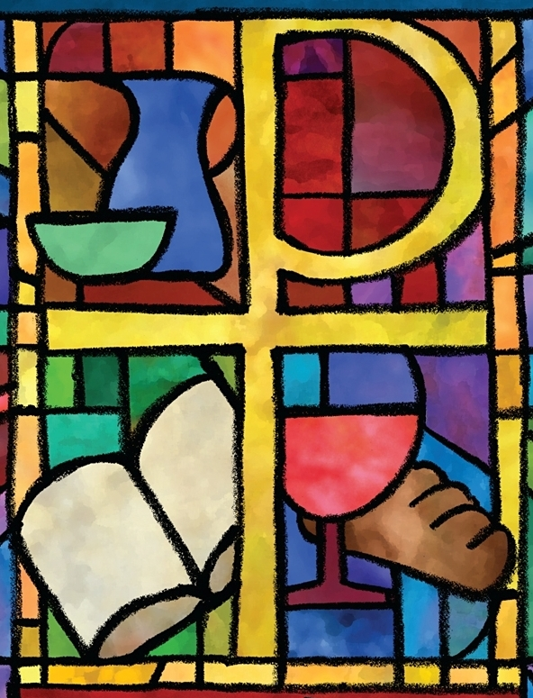

The PC(USA) Constitution on Eradicating
Systemic Poverty
Office of Theology and Worship
Presbyterian Church (U.S.A.)
Name of Presenter

Slide 2
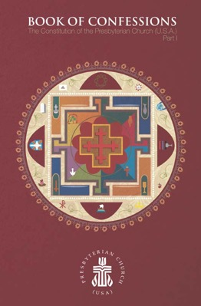
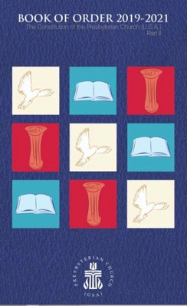
About This Presentation
All of the primary texts in this presentation come from the Constitution of the Presbyterian Church (U.S.A.), which is composed of The Book of Confessions (Part I) and The Book of Order (Part II).
Most images come from “Art in the Christian Tradition,” an online collection of the Jean and Alexander Heard Libraries of the Vanderbilt University Divinity School.

Slide 3
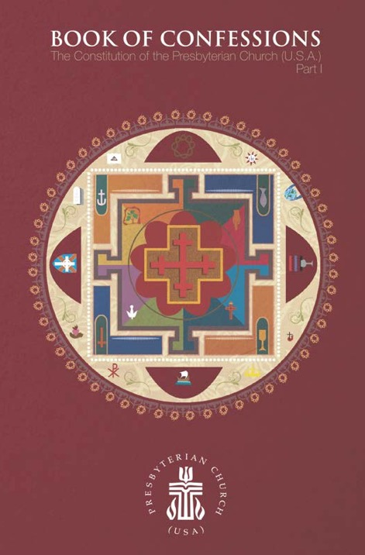
What Are the Confessions?
The Presbyterian Church (U.S.A.) states its faith and bears witness to God’s grace in Jesus Christ in the creeds and confessions in the Book of Confessions. In these statements the church declares to its members and to the world who and what it is, what it believes, and what it resolves to do. These statements identify the church as a community of people known by its convictions as well as by its actions.
—Book of Order, F-2.01

Slide 4
The Confession of 1967
Written for the United Presbyterian Church in the United States of America, the Confession of 1967 sought to address critical issues for the church and society in the mid-twentieth century. A key theme is reconciliation.
This presentation highlights excerpts from the Confession of 1967 pertaining to the work of eradicating systemic poverty.

Slide 5
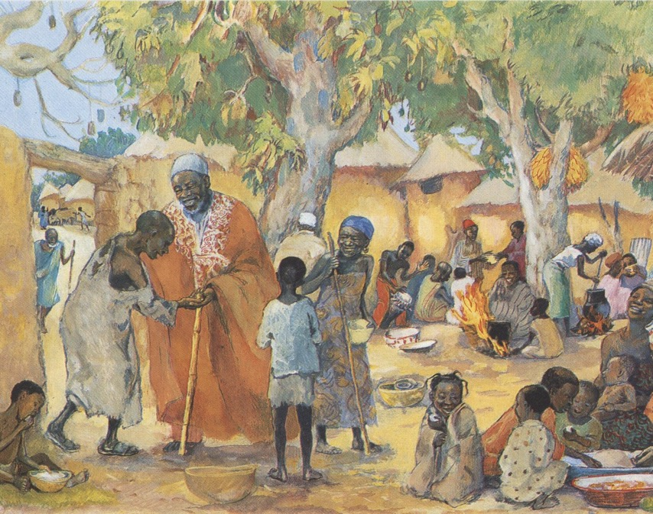
The Confession of 1967
The reconciliation of [humankind] through Jesus Christ makes it plain that enslaving poverty in a world of abundance is an intolerable violation of God’s good creation. Because Jesus identified himself with the needy and exploited, the cause of the world’s poor is the cause of his disciples.
“The Poor Invited to the Feast,” JESUS MAFA, 1973

Slide 6
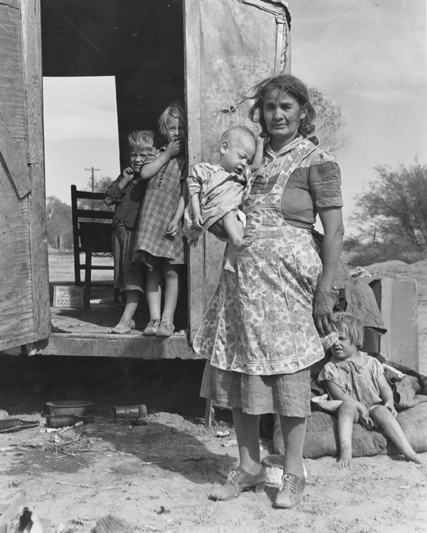
The Confession of 1967
The church cannot condone poverty, whether it is the product of unjust social structures, exploitation of the defenseless, lack of national resources, absence of technological understanding, or rapid expansion of populations. The church calls [all people] to use [their] abilities, [their] possessions, and the fruits of technology as gifts entrusted to [them] by God for the maintenance of [their] family and the advancement of the common welfare.
“On Arizona Highway 87,” Dorothea Lange, 1940

Slide 7
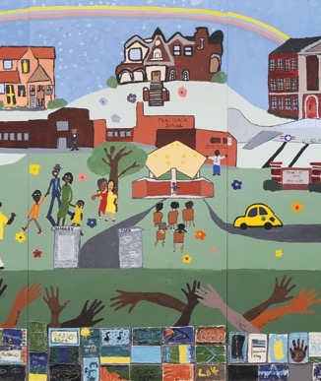
The Confession of 1967
It encourages those forces in human society that raise [people]’s hopes for better conditions and provide them with opportunity for a decent living. A church that is indifferent to poverty, or evades responsibility in economic affairs, or is open to one social class only, or expects gratitude for its beneficence makes a mockery of reconciliation and offers no acceptable worship to God.
—Book of Confessions, 9.46
“History of Our Community,” Becca Gannick, 2009

Slide 8

Questions for Discussion or Reflection
What does the Confession of 1967 have to say about eradicating systemic poverty?
With respect to systemic poverty, how does this confession declare who we are, what we believe, and what we resolve to do?
How does it state our convictions? How might it shape our actions?

Slide 9
The Confession of Belhar
Written in the Dutch Reformed Mission Church in the context of South African apartheid, the Confession of Belhar was adopted in 1986. It condemns the sin of racism and calls for unity and justice in the church.
This presentation highlights excerpts from the Confession of Belhar pertaining to the work of eradicating systemic poverty.

Slide 10
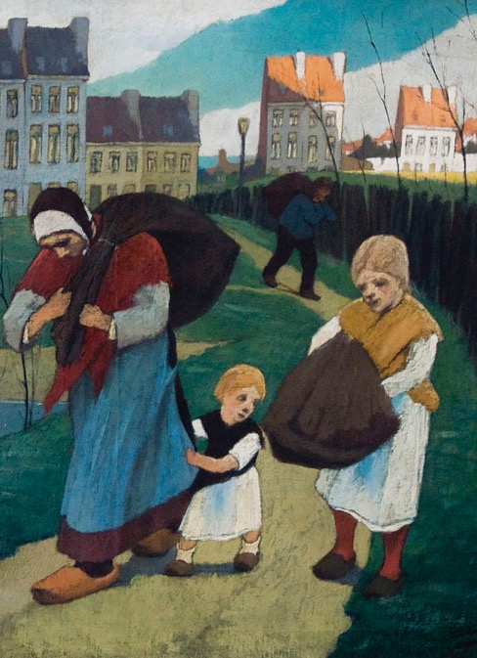
The Confession of Belhar
We believe
• that God has revealed God’s self as the one who wishes to bring about justice and true peace among people;
• that God, in a world full of injustice and enmity, is in a special way the God of the destitute, the poor and the wronged
• that God calls the church to follow God in this; for God brings justice to the oppressed and gives bread to the hungry;
“Rag Collectors,” Eugene Laermans, 1914

Slide 11
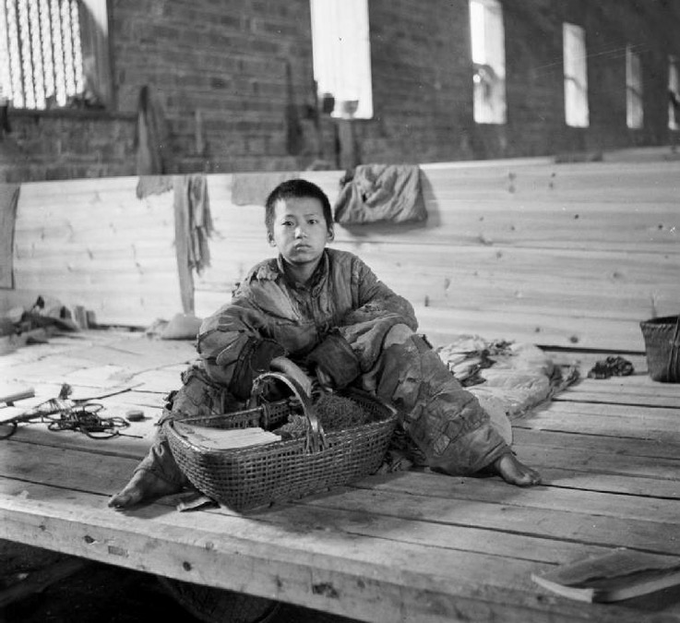
The Confession of Belhar
[We believe]
• that God frees the prisoner and restores sight to the blind;
• that God supports the downtrodden, protects the stranger, helps orphans and widows and blocks the path of the ungodly;
• that for God pure and undefiled religion is to visit the orphans and the widows in their suffering;
”Poor People’s Refuge in Changsa,” Cecil Beaton, 1944

Slide 12
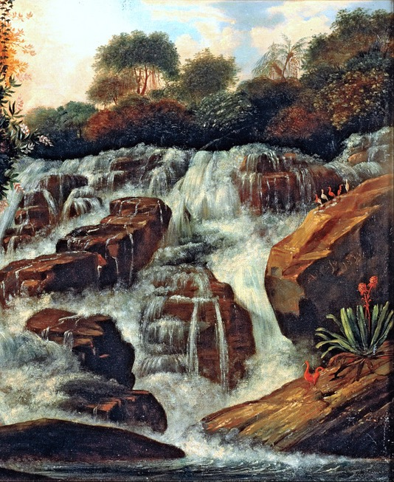
The Confession of Belhar
[We believe]
• that God wishes to teach the church to do what is good and to seek the right;
• that the church must therefore stand by people in any form of suffering and need, which implies, among other things, that the church must witness against and strive against any form of injustice, so that justice may roll down like waters, and righteousness like an ever-flowing stream;
“Great Tijuca Waterfall,” Manuel de Araújo, 1833

Slide 13
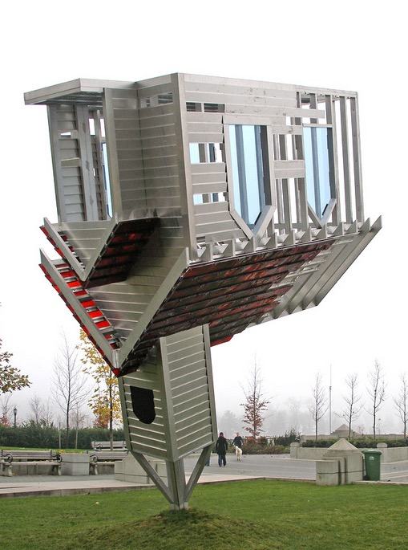
The Confession of Belhar
[We believe]
• that the church as the possession of God must stand where the Lord stands, namely against injustice and with the wronged;
• that in following Christ the church must witness against all the powerful and privileged who selfishly seek their own interests and thus control and harm others.
—Book of Confessions, 10.7
“Device to Root Out Evil,” Dennis Oppenheim, 1997

Slide 14
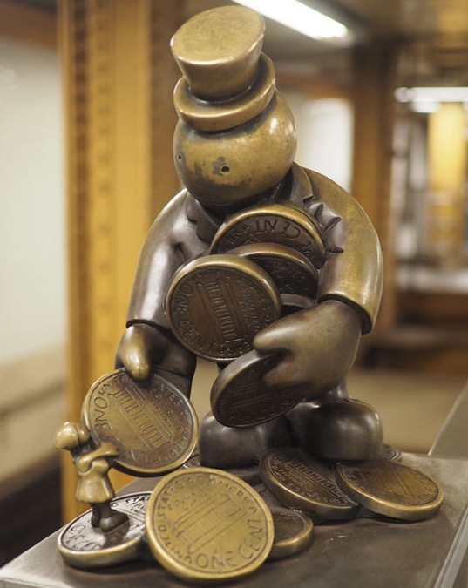
The Confession of Belhar
Therefore, we reject any ideology which would legitimate forms of injustice and any doctrine which is unwilling to resist such an ideology in the name of the gospel.
—Book of Confessions, 10.8
“Life Underground,” Tom Otterness, 21st Century

Slide 15
Questions for Discussion or Reflection
What does the Confession of Belhar have to say about eradicating systemic poverty?
With respect to systemic poverty, how does this confession declare who we are, what we believe, and what we resolve to do?
How does it state our convictions? How might it shape our actions?

Slide 16
A Brief Statement of Faith
Written in the time following the 1983 reunion that formed the Presbyterian Church (U.S.A.), A Brief Statement of Faith articulated the commitments and convictions of the new denomination. It is trinitarian in form and designed for use in worship.
This presentation highlights excerpts from A Brief Statement of Faith pertaining to the work of eradicating systemic poverty.

Slide 17
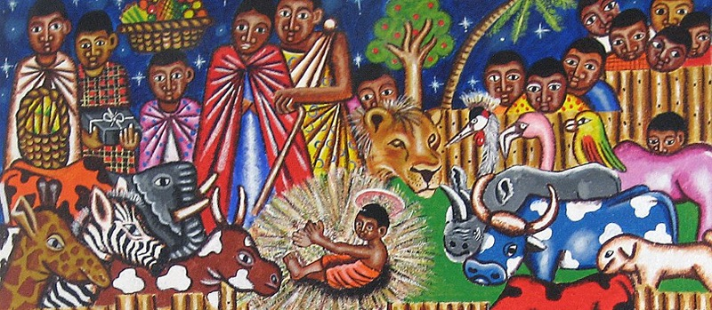
A Brief Statement of Faith
We trust in Jesus Christ,
fully human, fully God.
“Nativity,” Unidentified Kenyan Artist, 21st Century

Slide 18
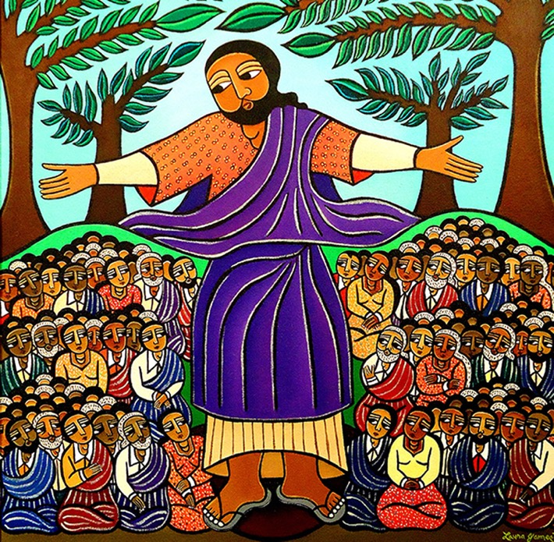
A Brief Statement of Faith
Jesus proclaimed the reign of God:
preaching good news to the poor
and release to the captives,
teaching by word and deed
and blessing the children,
healing the sick
and binding up the brokenhearted,
eating with outcasts,
forgiving sinners,
and calling all to repent
and believe the gospel.
“Sermon on the Mount,” Laura James, 2010

Slide 19
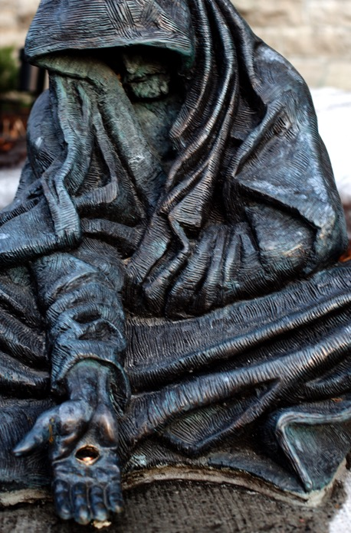
A Brief Statement of Faith
Unjustly condemned
for blasphemy and sedition,
Jesus was crucified,
suffering the depths of human pain
and giving his life
for the sins of the world.
God raised this Jesus from the dead,
vindicating his sinless life,
breaking the power of sin and evil,
delivering us from death to life eternal.
—Book of Confessions, 11.2
“Begging Jesus,” Timothy Schmalz, 2000

Slide 20
Questions for Discussion or Reflection
What does a Brief Statement of Faith have to say about eradicating systemic poverty?
With respect to systemic poverty, how does this confession declare who we are, what we believe, and what we resolve to do?
How does it state our convictions? How might it shape our actions?

Slide 21

The Foundations of Presbyterian Polity
The Foundations of Presbyterian Polity sets forth the principles that undergird the church’s mission, faith, and form of government.
This presentation highlights excerpts from the Foundations of Presbyterian Polity pertaining to the work of eradicating systemic poverty.

Slide 22
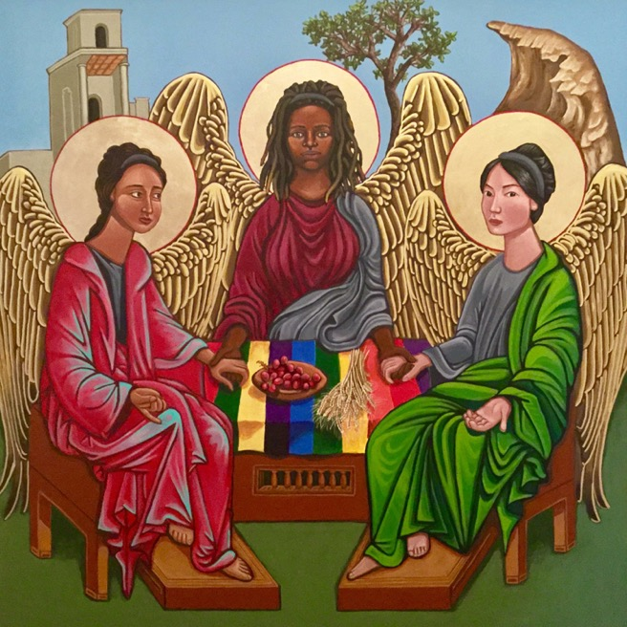
The Foundations of Presbyterian Polity
God’s Mission
The good news of the Gospel is that the triune God—Father, Son, and Holy Spirit—creates, redeems, sustains, rules, and transforms all things and all people. This one living God, the Scriptures say, liberated the people of Israel from oppression and covenanted to be their God.
— Book of Order, F-1.01
“Trinity,” Kelly Latimore, 2016

Slide 23
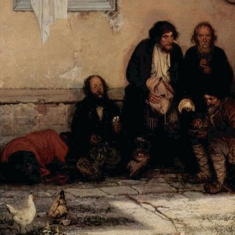
The Foundations of Presbyterian Polity
By the power of the Spirit, this one living God is incarnate in Jesus Christ, who came to live in the world, die for the world, and be raised again to new life. The Gospel of Jesus Christ announces the nearness of God’s kingdom, bringing good news to all who are impoverished, sight to all who are blind, freedom to all who are oppressed, and proclaiming the Lord’s favor upon all creation.
“The Bread Line,” Grigorij Grigorjewitsch Mjassojedow, 1872

Slide 24
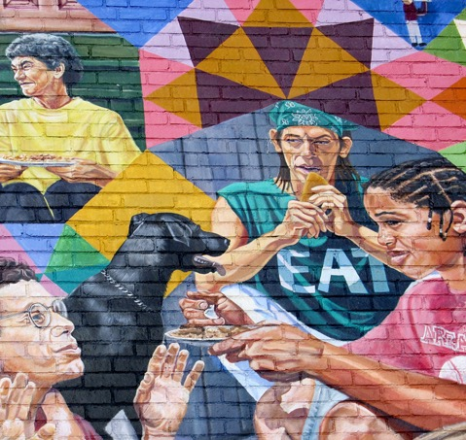
The Foundations of Presbyterian Polity
The mission of God in Christ gives shape and substance to the life and work of the Church. In Christ, the Church participates in God’s mission for the transformation of creation and humanity by proclaiming to all people the good news of God’s love, offering to all people the grace of God at font and table, and calling all people to discipleship in Christ.
“Potluck,” David Fichter, 1994

Slide 25
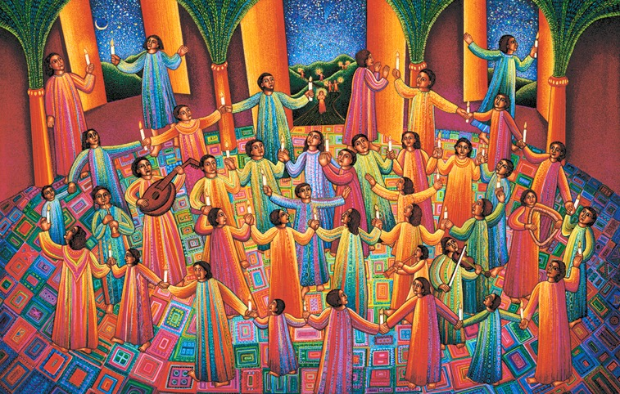
The Foundations of Presbyterian Polity
Human beings have no higher goal in life than to glorify and enjoy God now and forever, living in covenant fellowship with God and participating in God’s mission.
— Book of Order, F-1.01
“Celebration,” John August Swanson, 1997

Slide 26
Questions for Discussion or Reflection
What does the section on “God’s Mission” in the Foundations of Presbyterian Polity have to say about eradicating systemic poverty?
With respect to systemic poverty and in light of the Confessions, how do the Foundations of Presbyterian Polity inform the identity and mission of the church?
How can Presbyterian polity contribute to eradicating systemic poverty?

Slide 27
The Form of Government
The Form of Government establishes the organization of the denomination, defining membership and ministry and determining structures of oversight for the church’s mission.
This presentation highlights excerpts from the Form of Government pertaining to the work of eradicating systemic poverty.

Slide 28
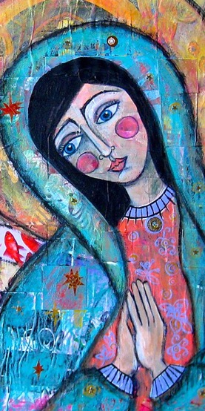
The Form of Government
Deacon Defined
The ministry of deacon as set forth in Scripture is one of compassion, witness, and service, sharing in the redeeming love of Jesus Christ for the poor, the hungry, the sick, the lost, the friendless, the oppressed, those burdened by unjust policies or structures, or anyone in distress. Persons of spiritual character, honest repute, exemplary lives, brotherly and sisterly love, sincere compassion, and sound judgment should be chosen for this ministry.
— Book of Order, G-2.0201
“Merciful Mother,” Jessica
Jane Lynch, 21st Century

Slide 29
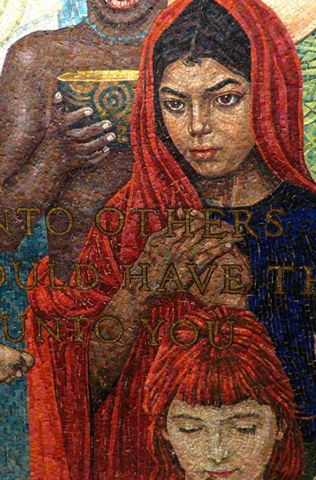
The Form of Government
Ruling Elder Defined
As there were in Old Testament times elders for the government of the people, so the New Testament church provided persons with particular gifts to share in discernment of God’s Spirit and governance of God’s people. Accordingly, congregations should elect persons of wisdom and maturity of faith, having demonstrated skills in leadership and being compassionate in spirit.
— Book of Order, G-2.0301
“Golden Rule,” United Nations Mosaic, 1985

Slide 30
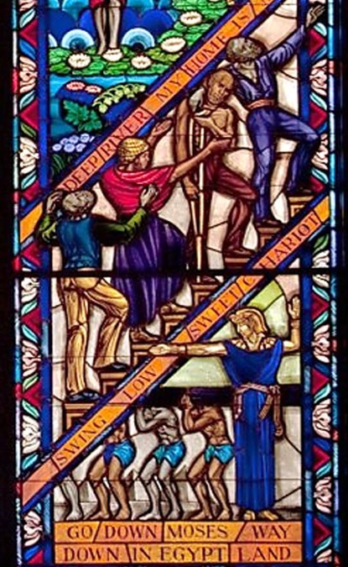
The Form of Government
Pastoral Relationships
When ministers of the Word and Sacrament are called as pastor, co-pastor, or associate pastor of a congregation, they are to be responsible for a quality of life and relationships that commends the gospel to all persons and that communicates its joy and justice. They are responsible for studying, teaching, and preaching the Word, for celebrating Baptism and the Lord’s Supper, and for praying with and for the congregation.
“Singing Windows,” Tuskegee University, 1969

Slide 31
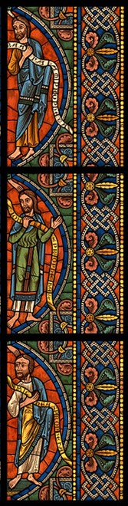
The Form of Government
With the ruling elders, they are to encourage people in the worship and service of God; to equip and enable them for their tasks within the church and their mission in the world; to exercise pastoral care, devoting special attention to the poor, the sick, the troubled, and the dying; to participate in governing responsibilities, including leadership of the congregation in implementing the principles of participation and inclusiveness in the decision-making life of the congregation, and its task of reaching out in concern and service to the life of the human community as a whole.
“Tree of Jesse,”
Chartres Cathedral, 1145

Slide 32
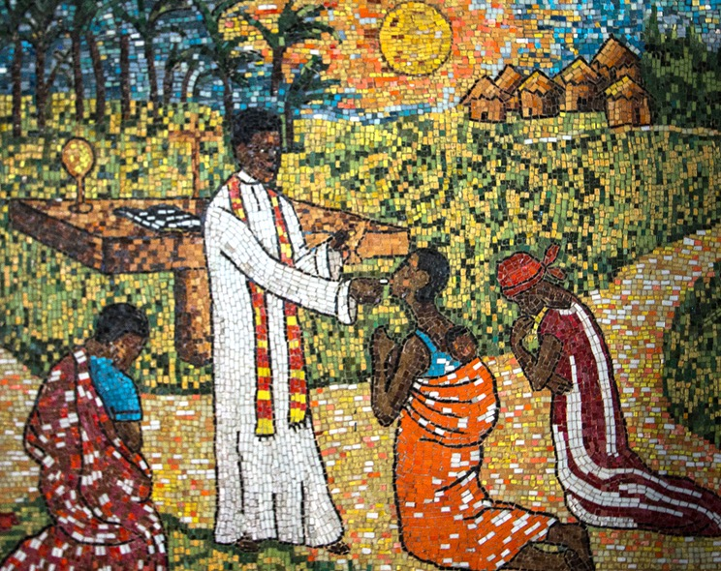
The Form of Government
With the deacons they are to share in the ministries of compassion, witness, and service. In addition to these pastoral duties, they are responsible for sharing in the ministry of the church in councils higher than the session and in ecumenical relationships.
— Book of Order, G-2.0504
“Sharing Communion,” Cathedral of St. Paul, Abidjan, Ivory Coast, 20th Century

Slide 33
Questions for Discussion or Reflection
What do the ministries of deacons, ruling elders, and pastors have to do with eradicating systemic poverty?
With respect to systemic poverty and in light of the Confessions, how does the Form of Government inform the identity and mission of the church?
How are we called to eradicate systemic poverty through the governance of the church?

Slide 34
The Directory for Worship
The Directory for Worship presents the denomination’s theology and practice of worship, with an understanding of worship that includes service to God and neighbor.
This presentation highlights excerpts from the Directory for Worship pertaining to the work of eradicating systemic poverty.

Slide 35
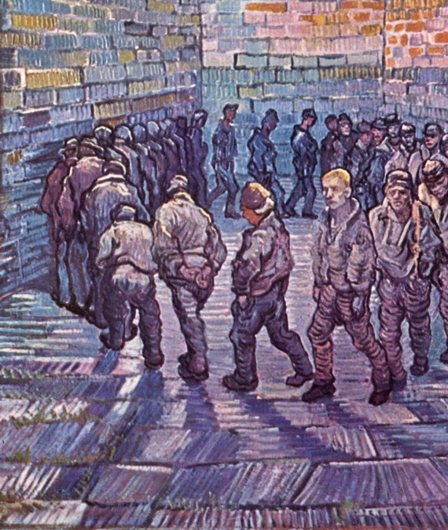
The Directory for Worship
Compassion
God sends the Church to show compassion in the world: feeding the hungry, caring for the sick, visiting prisoners, freeing captives, sheltering the homeless, welcoming strangers, comforting those who mourn, and being present with all who are in need. These acts of compassion, done corporately or individually, are the work of the Church as the body of Christ.
“Prisoners Exercising,” Vincent van Gogh, 1890

Slide 36
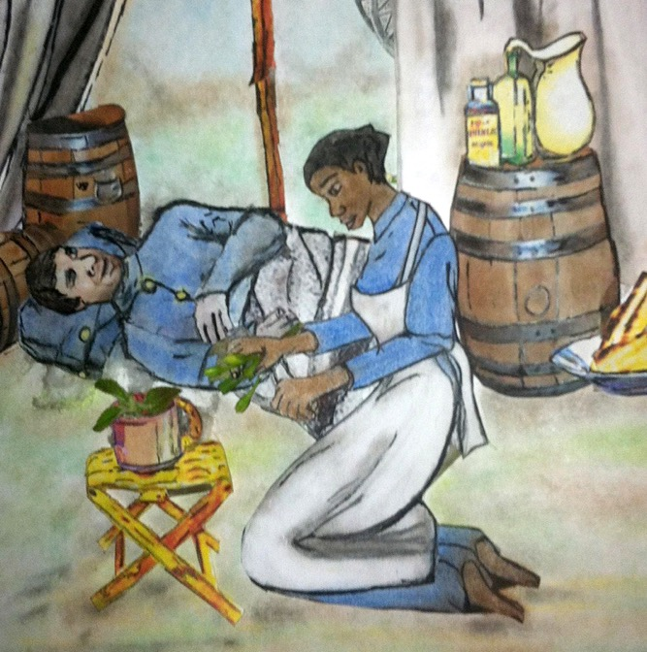
The Directory for Worship
We are called to minister directly to people’s immediate hurts and needs. We are also called to confront and challenge systems that perpetuate human misery. We participate in Christ’s compassionate ministry through local acts of witness and advocacy, through the programs of the larger church, and in cooperation with other agencies and organizations committed to human welfare.
“Lucy Higgs Tending to the Wounded,” Kathy Grant, 2013

Slide 37
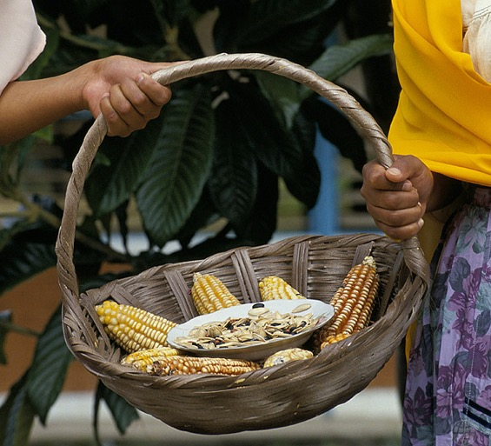
The Directory for Worship
In the Service for the Lord’s Day, God’s call to compassion is proclaimed in the Word and enacted through the Sacraments. We confess our complicity in oppressive structures, pray for those who are hurting, offer our resources to alleviate suffering, and commit our time and energy to care for those in need.
“Women Holding a Basket of Corn,” Curt Carnemark, 2008

Slide 38
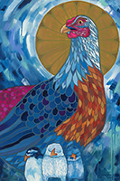
The Directory for Worship
Following the example of Jesus Christ, we pledge that we will respect the dignity of all, reach out to those judged undeserving, receive as well as give, and even risk our lives to show Christ’s love.
—Book of Order, W-5.0303
“Mother Hen,” Lauren Wright Pittman, 2018

Slide 39
Questions for Discussion or Reflection
What does the Directory for Worship passage on “Compassion” have to say about eradicating systemic poverty?
With respect to systemic poverty and in light of the Confessions, how does the Directory for Worship inform the identity and mission of the church?
How are we called to eradicate systemic poverty in worship?

Slide 40
Additional Resources
For more information on the Matthew 25 vision of the Presbyterian Church (U.S.A.), including resources for eradicating systemic poverty, visit pcusa.org/Matthew25.

