Slide 1
Environmental Racism &
Justice
Presbyterian Hunger Program

Slide 2
What do you think of when you hear “environmental racism?”
Watch “environmental justice explained”
  https://www.youtube.com/watch?v=dREtXUij6_c
Notes:
https://www.youtube.com/watch?v=dREtXUij6_c
Video from Grist “environmental justice explained”
Thoughts, comments, reactions (2-3 minutes)

Slide 3
Peru
North Carolina
Rural
Urban
Flint

Slide 4
Small Group Questions
What is the make-up of the affected community?
What environmental issues-- and what economic issues-- were involved?
How have/how can people of faith respond? What brings hope?
What is your group’s main “take-away?”

Slide 5
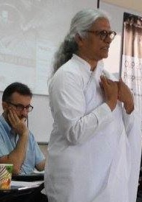
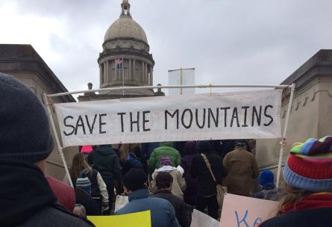
Micah 6:8
What does the Holy One require of you but to do justice, and to love kindness, and to walk humbly with your God?

Slide 6
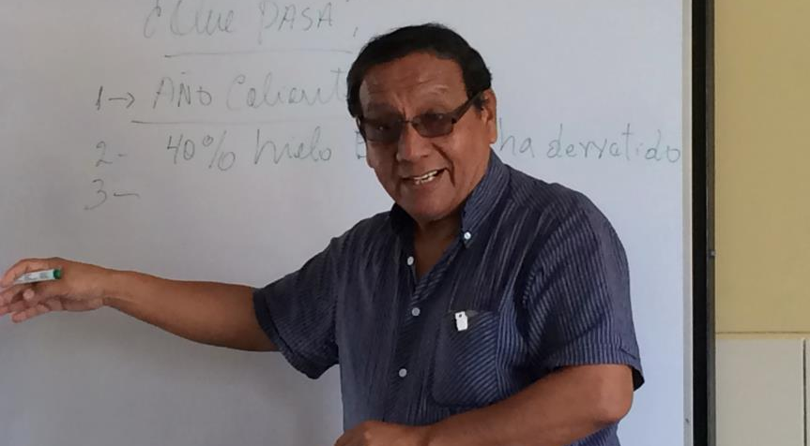
Report back: Que pasa?
Notes:
Important for us to learn the skills of being succinct and describing what we’ve learned (action skill building)
Report back- what’s your main take-away, and what can people of faith do? (20 sec commercials)
What are race realities? Other examples of enviro racism?

Slide 7
Race as Key Component
Watch video below:
  https://www.youtube.com/watch?v=TrbeuJRPM0o
Notes:
https://www.youtube.com/watch?v=TrbeuJRPM0o

Slide 8
What can you do?
  Listen to and learn from the people most affected
  Acknowledge the role we all play and the impact of our choices
  Speak up and ask hard questions
  Use any privilege or platform you have to make it better
  Spread awareness—talk with your parents, your church, your school, decision-makers—about these issues

