Slide 1
IT Development
How we serve Presbyterian Church (USA)

Slide 2
About Me: Denise Govindarajan
IT Development Manager
Serving the church for over 14 years
Software Engineer for over 25 years
Experience with several programming languages and platforms
Manage projects and development staff
Notes:
Test me now – what do I do?

Slide 3
IT Development’s Role in PC(USA)
Create new software programs
Maintain/update existing software programs
Build/maintain servers for in-house developed software
Help identify/provide software solutions for difficult business processes
Construct/create databases to store valuable church data
Create reports to provide important datasets as needed
Share the mission of the church by providing websites
Providing links to social media through websites for better communication

Slide 4

IT Development Team
Jim Phares
Richard Embry
Denise Govindarajan

Slide 5
Services provided throughout PC(USA)
Human Resources
  Performance Management System
Building Services
  Incident Reporting
Accounting
  Interface programs for the Financial Edge System (FE)
  Financial Management System (FMS)
  Cost Recovery for GL Accounts
Notes:
Performance Management System – Used for Mid Year and Annual Reviews
Incident Reporting – Application to record accidents/injury.
Interface Programs –
FMS –
Cost Recovery -

Slide 6
Services provided throughout PC(USA) (Cont.)
Presbyterian Investment & Loans Program (PILP)
  Payer Express Interface Program (In cooperation with PNC Bank)
  Maintain pilp.pcusa.org
Compassion, Peace & Justice
  Self Development of People (SDOP)
World Mission
  World Mission Itineration (wm.pcusa.org)
Notes:
Payer Express – Formats data to be fed to the PNC Payer Express website.
Self Development of People -
World Mission – Used by Mission Co-Workers to coordinate activities such as speaking at Synods, Presbyteries and Congregations.

Slide 7
Services provided throughout PC(USA) (Cont.)
PC(USA)
  Event Registration (events.pcusa.org)
  PC(USA) Website (www.pcusa.org)
  Mid Council Engagement (mce.pcusa.org)
  Donations (www.presbyterianmission.org)
Notes:
Event Registration – Used to register participants and collect payment for conference and events.
Mid Council Engagement – Records and tracks communication between the Center staff and Presbyteries and Synods.
Donation - Press Give or search for a particular fund or choose a category or ministry area.

Slide 8
Current Projects
Research Services
  Ten Year Trends (rewriting Church Trends)
World Mission
  Mission Personnel (MPDS) and One Door (rewriting/integrating to Mission Service)
Accounting
  Impressions
Notes:
Ten Year Trends –
MPDS/One Door –
Impressions -

Slide 9
Examples of websites development supports
Presbyterian Mission Website
Presbyterian Gifts

Slide 10
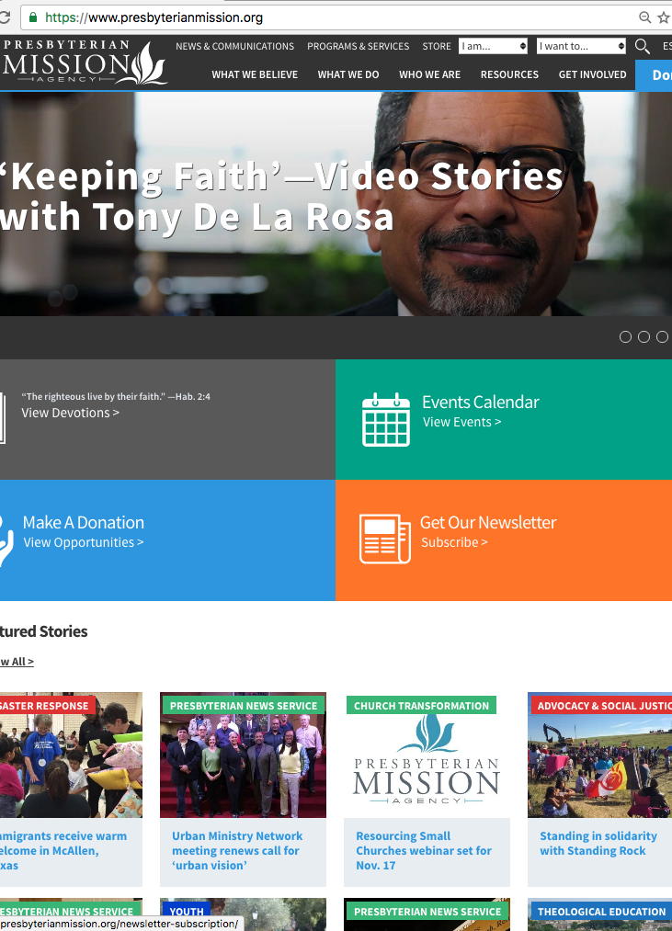
New pma website
Deployed in May 2016
Responsive Design
Clean look
Easy navigation
Notes:
The PMA website features Who We Are, What We Do, Resources and presents Donation opportunities.

Slide 11
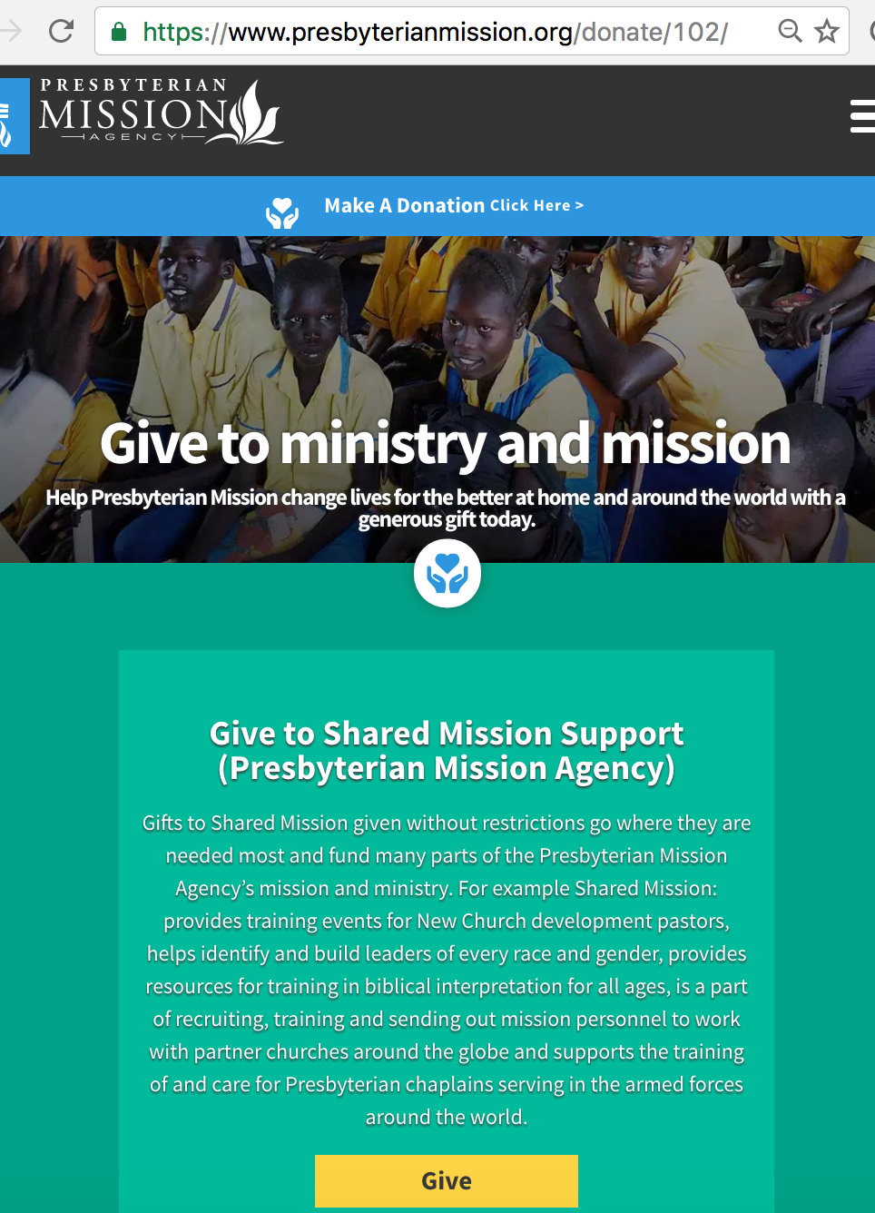
Donation Process
Click the Donate Button
Give where the need is greatest

Slide 12
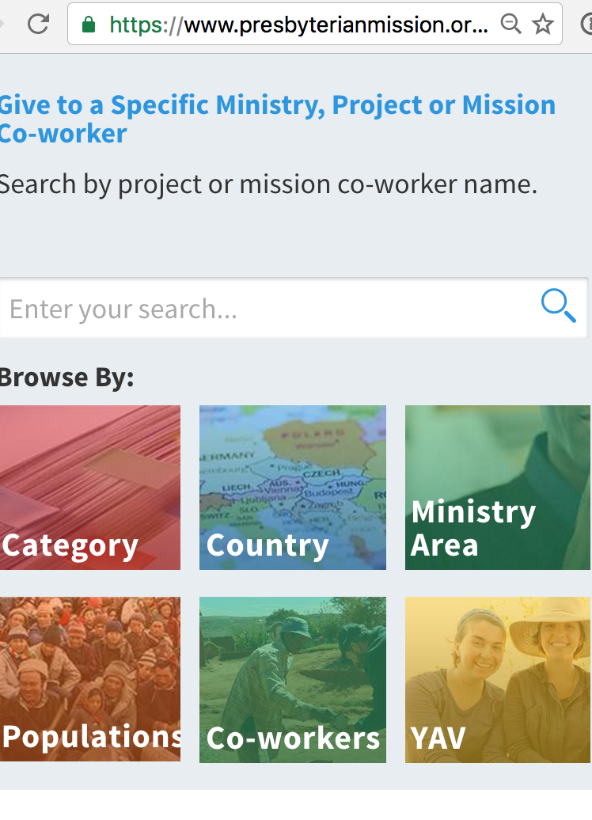
Giving opportunities
Give by:
  Category
  Country
  Ministry Area
  Population
  Co-Workers
  YAV
Notes:
Category – Hunger, Poverty, Social Justice, Education
Population – Refugees, Racial Ethnic Groups, Disabled and Special Need

Slide 13
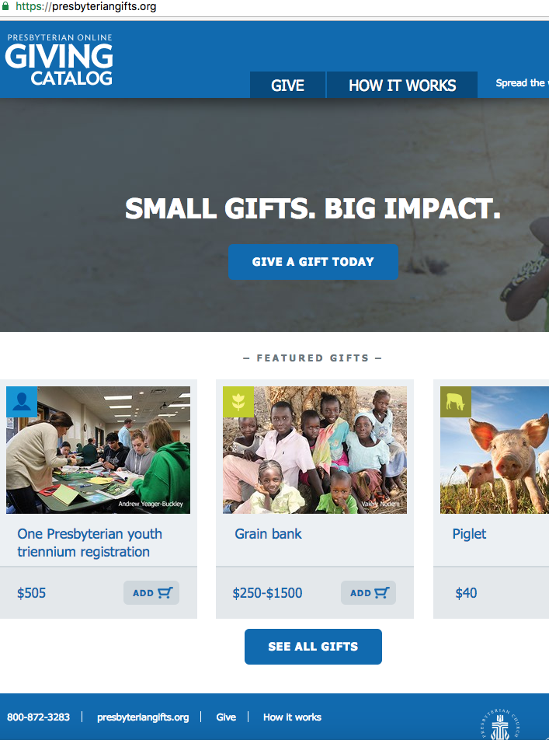
Presbyterian Gifts
https://presbyteriangifts.org
Giving Catalog
Features include a shopping cart
Spread the word through Social Media
Notes:
The concept here is a gift can be chose such as a piglet which has a value of $40. That $40 can cover the cost of a piglet.
This website features a shopping cart provides the ability to spread the word through social media.

Slide 14
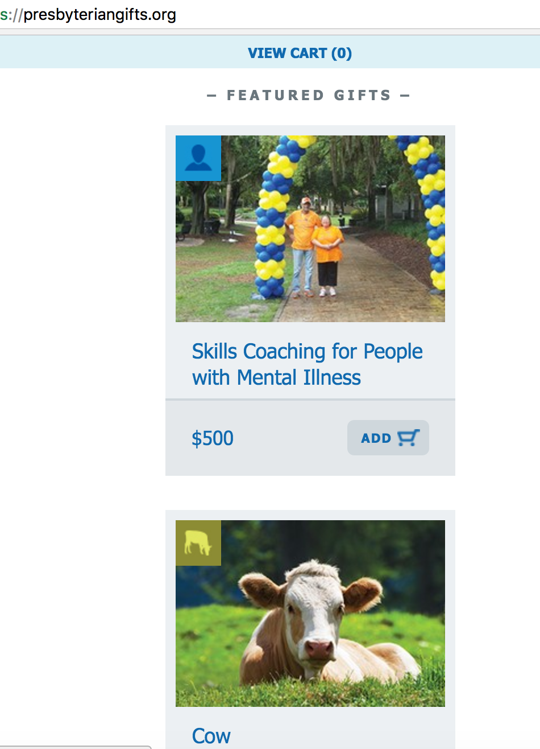
Featured Gifts
Certain gifts can be featured based on need
Icons at the top left represent the Gift Category
  The icon on the first picture indicates the People Category
  The icon on the second picture indicates the Livestock Category

Slide 15
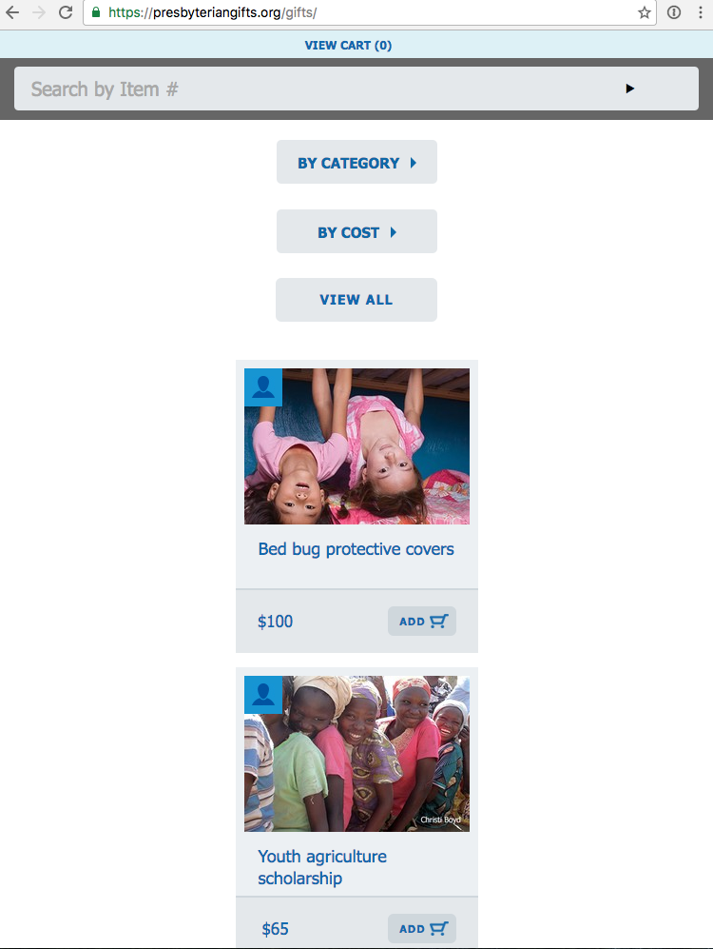
Select gifts by category or cost
Categories: Livestock, Water, Agriculture, People, etc.
Cost: Highest to Lowest, Lowest to Highest
You can also search for a specific giving opportunity

Slide 16
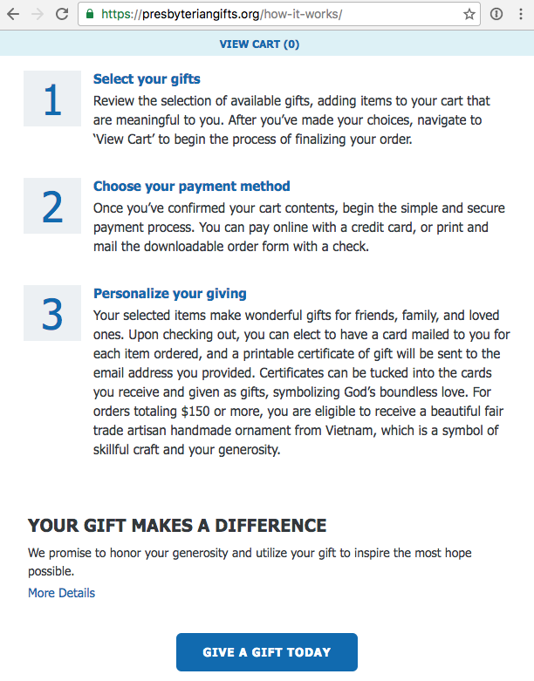
How it works
Select your gifts
Choose your payment method
Personalize your giving of gifts for friends, family, and loved ones. Upon checking out, you can elect to have a card mailed to you for each item ordered and a printable certificate of gift will be sent to the email address you provided.

Slide 17
Thank you!
Jim Phares
Richard Embry
Denise Govindarajan

Slide 18

Thank you for your time and attention

