Slide 1
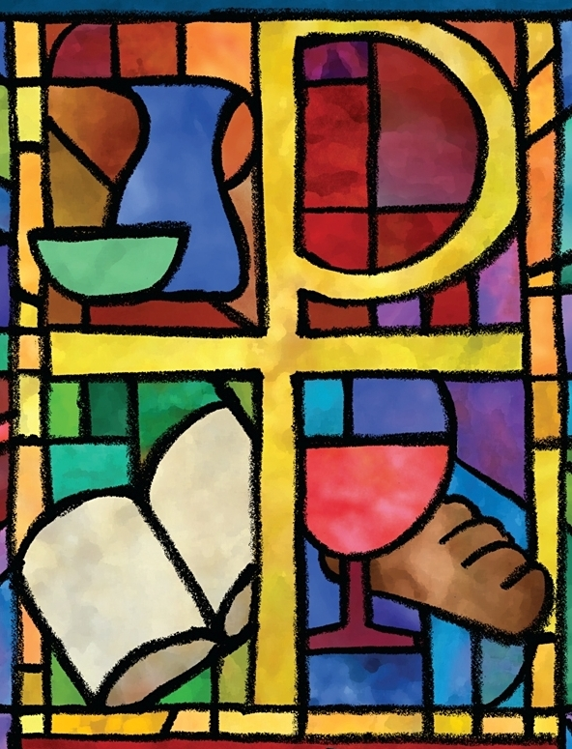
The PC(USA) Constitution on Building Congregational Vitality
Office of Theology and Worship Presbyterian Church (U.S.A.)
Name of Presenter

Slide 2
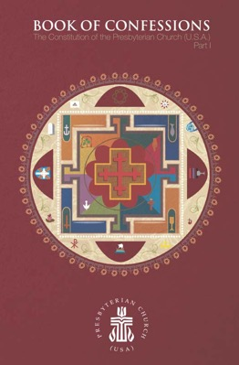
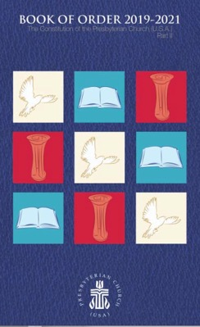
About This Presentation
All of the primary texts in this presentation come from the Constitution of the Presbyterian Church (U.S.A.), which is composed of The Book of Confessions (Part I) and The Book of Order (Part II).
Most images come from “Art in the Christian Tradition,” an online collection of the Jean and Alexander Heard Libraries of the Vanderbilt University Divinity School.

Slide 3
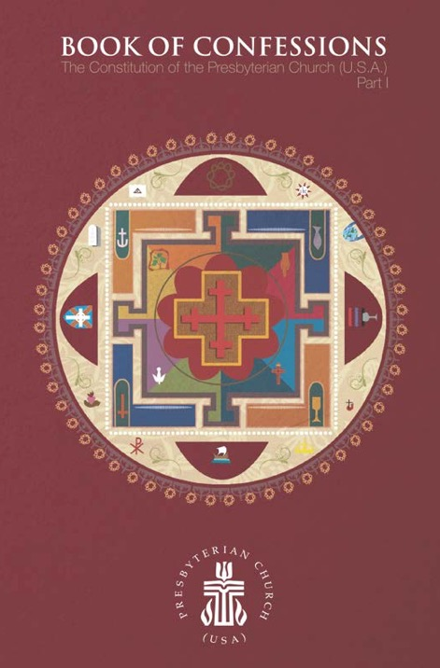
What Are the Confessions?
The Presbyterian Church (U.S.A.) states its faith and bears witness to God’s grace in Jesus Christ in the creeds and confessions in the Book of Confessions. In these statements the church declares to its members and to the world who and what it is, what it believes, and what it resolves to do. These statements identify the church as a community of people known by its convictions as well as by its actions. —Book of Order, F-2.01

Slide 4
The Confession of 1967
Written for the United Presbyterian Church in the United States of America, the Confession of 1967 sought to address critical issues for the church and society in the mid-twentieth century. A key theme is reconciliation.
This presentation highlights excerpts from the Confession of 1967 pertaining to the work of building congregational vitality.

Slide 5
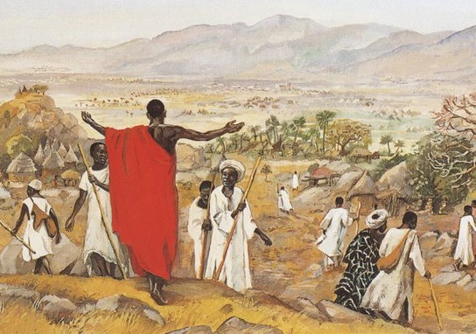
The Confession of 1967
Wherever the church exists, its members are both gathered in corporate life and dispersed in society for the sake of mission in the world. —Book of Confessions, 9.35
“The Mission to the World,” JESUS MAFA 1973

Slide 6
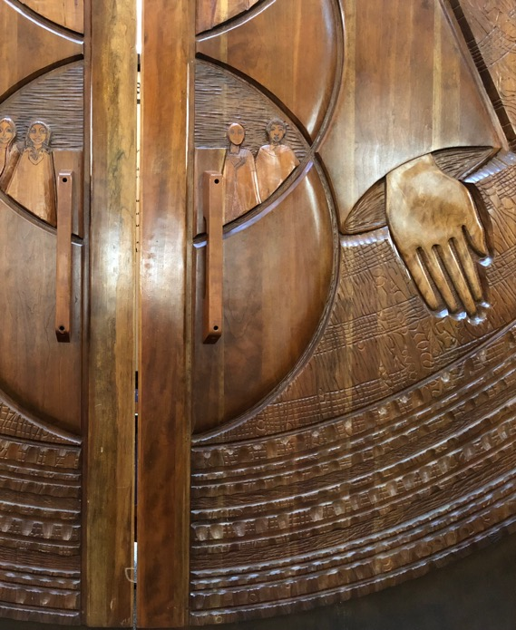
The Confession of 1967
The church gathers to praise God, to hear [God’s] word for [humankind], to baptize and to join in the Lord’s Supper, to pray for and present the world to [God] in worship, to enjoy fellowship, to receive instruction, strength, and comfort, to order and organize its own corporate life, to be tested, renewed, and reformed, and to speak and act in the world’s affairs as may be appropriate to the needs of the time. —Book of Confessions, 9.36
Presbyterian Center Chapel Doors, Federico Armijo, 1996

Slide 7
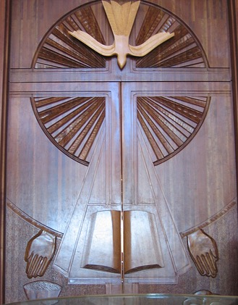
The Confession of 1967
The church disperses to serve God wherever its members are, at work or play, in private or in the life of society. Their prayer and Bible study are part of the church’s worship and theological reflection. Their witness is the church’s evangelism. Their daily action in the world is the church in mission to the world. The quality of their relation with other persons is the measure of the church’s fidelity. —Book of Confessions, 9.37
Presbyterian Center Chapel Doors, Federico Armijo, 1996

Slide 8
Questions for Discussion or Reflection
What does the Confession of 1967 have to say about building congregational vitality?
With respect to congregational vitality, how does this confession declare who we are, what we believe, and what we resolve to do?
How does it state our convictions? How might it shape our actions?

Slide 9
The Confession of Belhar
Written in the Dutch Reformed Mission Church in the context of South African apartheid, the Confession of Belhar was adopted in 1986. It condemns the sin of racism and calls for unity and justice in the church.
This presentation highlights excerpts from the Confession of Belhar pertaining to the work of building congregational vitality.

Slide 10
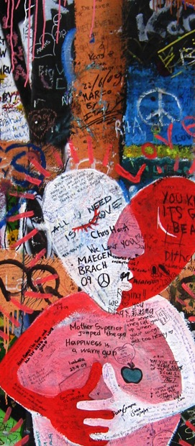
The Confession of Belhar
We believe
• that Christ’s work of reconciliation is made manifest in the church as the community of believers who have been reconciled with God and with one another;
• that unity is, therefore, both a gift and an obligation for the church of Jesus Christ; that through the working of God’s Spirit it is a binding force, yet simultaneously a reality which must be earnestly pursued and sought: one which the people of God must continually be built up to attain;
John Lennon Wall, Prague,
Czech Republic, 2009

Slide 11
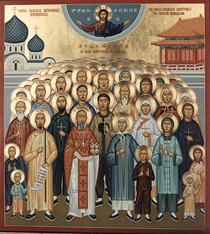
The Confession of Belhar
[We believe]
• that this unity must become visible so that the world may believe that separation, enmity and hatred between people and groups is sin which Christ has already conquered, and accordingly that anything which threatens this unity may have no place in the church and must be resisted;
“Chinese Martyrs,” Orthodox Icon, ca. 1900

Slide 12
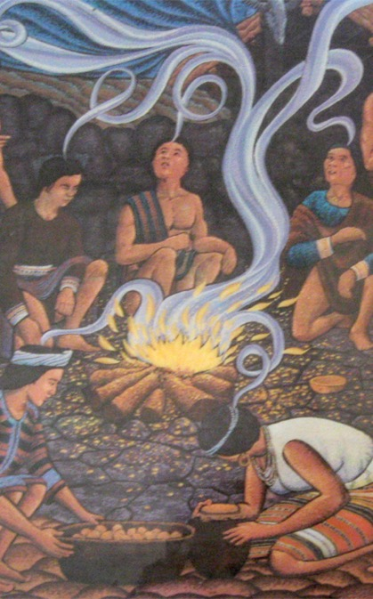
The Confession of Belhar
• that this unity of the people of God must be manifested and be active in a variety of ways:
° in that we love one another;
° that we experience, practice and pursue community with one another;
° that we are obligated to give ourselves willingly and joyfully to be of benefit and blessing to one another;
° that we share one faith, have one calling, are of one soul and one mind;
“Pentecost,” Bontoc, Philippines, 1980

Slide 13
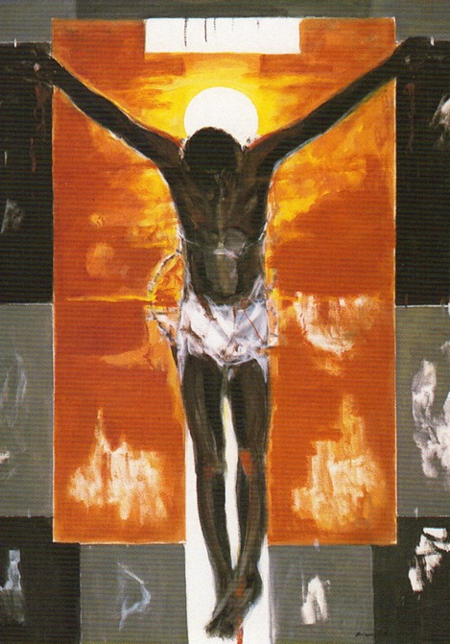
The Confession of Belhar
° have one God and Father, are filled with one Spirit, are baptized with one baptism, eat of one bread and drink of one cup, confess one name, are obedient to one Lord, work for one cause, and share one hope;
° together come to know the height and the breadth and the depth of the love of Christ;
° together are built up to the stature of Christ, to the new humanity;
“Cristo Negro,” Martin Ruiz Anglada, 1995

Slide 14
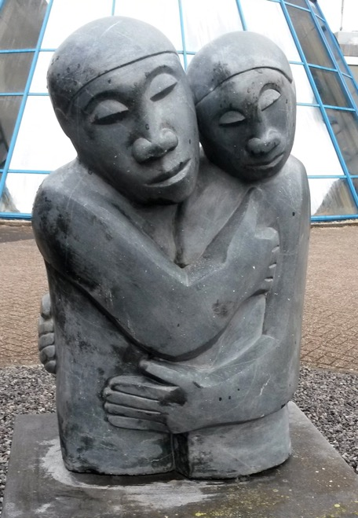
The Confession of Belhar
° together know and bear one another’s burdens, thereby fulfilling the law of Christ;
° that we need one another and upbuild one another, admonishing and comforting one another;
° that we suffer with one another for the sake of righteousness; pray together; together serve God in this world; and together fight against all which may threaten or hinder this unity;
“Reconciliation,” Amos Supuni, ca. 1991–2008

Slide 15
The Confession of Belhar
[We believe]
• that this unity can be established only in freedom and not under constraint; that the variety of spiritual gifts, opportunities, backgrounds, convictions, as well as the various languages and cultures, are by virtue of the reconciliation in Christ, opportunities for mutual service and enrichment within the one visible people of God;
• that true faith in Jesus Christ is the only condition for membership of this church. —Book of Confessions, 10.3
”Entry of Christ into Jerusalem,” Wilhelm Morgner, 1912

Slide 16
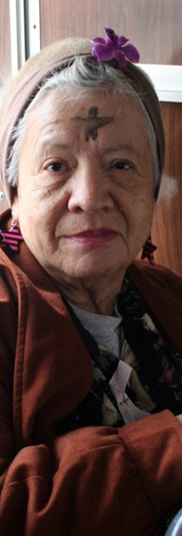
The Confession of Belhar
Therefore, we reject any doctrine
• which absolutizes either natural diversity or the sinful separation of people in such a way that this absolutization hinders or breaks the visible and active unity of the church, or even leads to the establishment of a separate church formation;
• which professes that this spiritual unity is truly being maintained in the bond of peace while believers of the same confession are in effect alienated from one another for the sake of diversity and in despair of reconciliation;
“Ash Wednesday,”
Art Siegel, 2006

Slide 17
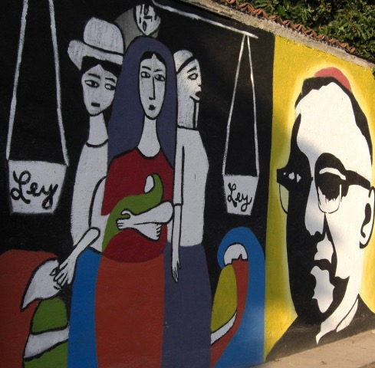
The Confession of Belhar
[Therefore, we reject any doctrine]
• which denies that a refusal earnestly to pursue this visible unity as a priceless gift is sin;
• which explicitly or implicitly maintains that descent or any other human or social factor should be a consideration in determining membership of the church. —Book of Confessions, 10.4
Mural of Monseñor Romero, El Salvador, 2007

Slide 18
Questions for Discussion or Reflection
What does the Confession of Belhar have to say about building congregational vitality?
With respect to congregational vitality, how does this confession declare who we are, what we believe, and what we resolve to do?
How does it state our convictions? How might it shape our actions?

Slide 19
A Brief Statement of Faith
Written in the time following the 1983 reunion that formed the Presbyterian Church (U.S.A.), A Brief Statement of Faith articulated the commitments and convictions of the new denomination. It is trinitarian in form and designed for use in worship.
This presentation highlights excerpts from A Brief Statement of Faith pertaining to the work of building congregational vitality.

Slide 20
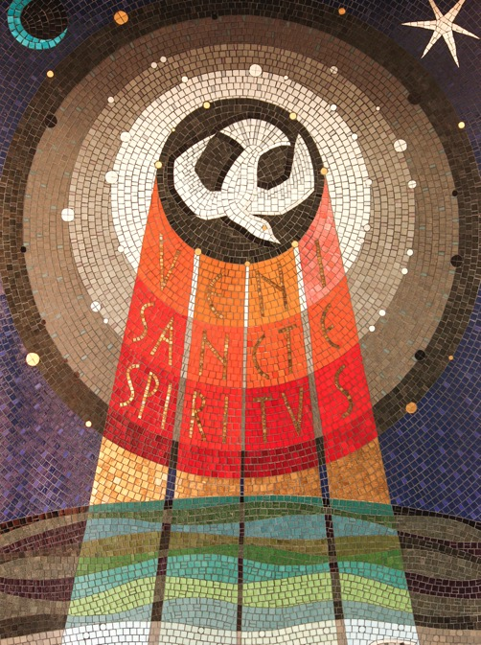
A Brief Statement of Faith
We trust in God the Holy Spirit, everywhere the giver and renewer of life.
“Veni Sancte Spiritus,” Adam Kossowski, 1965

Slide 21
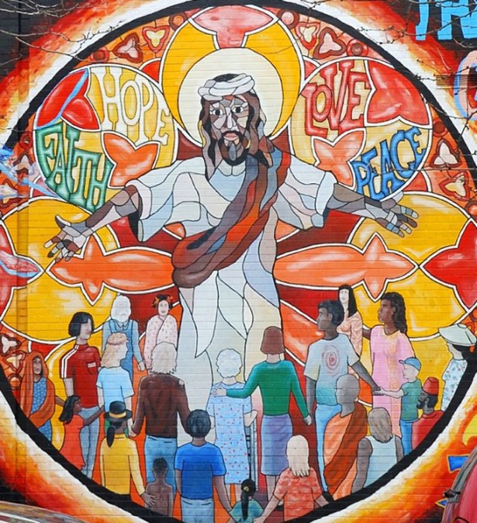
A Brief Statement of Faith
The Spirit justifies us by grace through faith, sets us free to accept ourselves and to love God and neighbor, and binds us together with all believers in the one body of Christ, the Church.
“Jesus Mural,” Chicago, United States, 20th Century

Slide 22
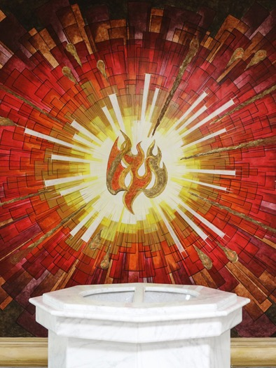
A Brief Statement of Faith
The same Spirit who inspired the prophets and apostles rules our faith and life in Christ through Scripture, engages us through the Word proclaimed, claims us in the waters of baptism, feeds us with the bread of life and the cup of salvation, and calls women and men to all ministries of the Church.
Baptismal Font, Mexicali, Mexico, 20th Century

Slide 23
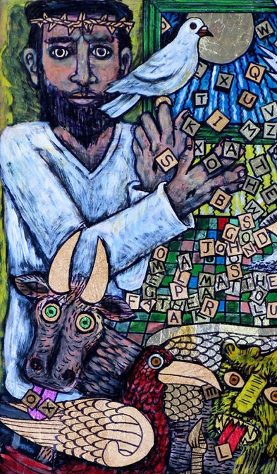
A Brief Statement of Faith
In a broken and fearful world the Spirit gives us courage to pray without ceasing, to witness among all peoples to Christ as Lord and Savior, to unmask idolatries in Church and culture, to hear the voices of peoples long silenced, and to work with others for justice, freedom, and peace.
“In the Beginning,” Brian Whelan, 2003

Slide 24
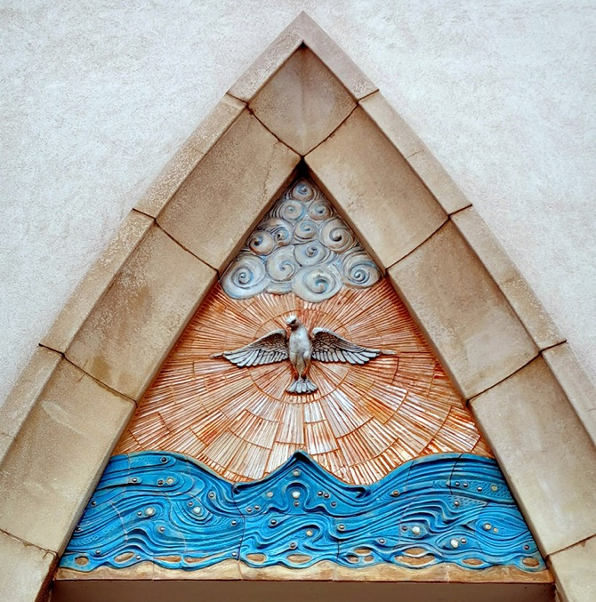
A Brief Statement of Faith
In gratitude to God, empowered by the Spirit, we strive to serve Christ in our daily tasks and to live holy and joyful lives, even as we watch for God’s new heaven and new earth, praying, “Come, Lord Jesus!”
—Book of Confessions, 11.4
“Coming of the Holy Spirit,” Eva Kun, 2016

Slide 25
Questions for Discussion or Reflection
What does a Brief Statement of Faith have to say about building congregational vitality?
With respect to congregational vitality, how does this confession declare who we are, what we believe, and what we resolve to do?
How does it state our convictions? How might it shape our actions?

Slide 26
The Foundations of Presbyterian Polity
The Foundations of Presbyterian Polity sets forth the principles that undergird the church’s mission, faith, and form of government.
This presentation highlights excerpts from the Foundations of Presbyterian Polity pertaining to the work of building congregational vitality.

Slide 27
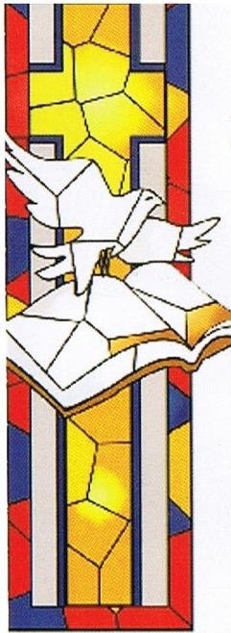
The Foundations of Presbyterian Polity
The Great Ends of the Church
The great ends of the Church are: the proclamation of the gospel for the salvation of humankind; the shelter, nurture, and spiritual fellowship of the children of God; the maintenance of divine worship; the preservation of the truth; the promotion of social righteousness; and the exhibition of the Kingdom of Heaven to the world. — Book of Order, F-1.0304
Great Ends of the Church Banners, PC(USA), 20th Century

Slide 28
Questions for Discussion or Reflection
What do the “Great Ends of the Church” in the Foundations of Presbyterian Polity have to say about building congregational vitality?
With respect to congregational vitality and in light of the Confessions, how do the Foundations of Presbyterian Polity inform the identity and mission of the church?
How can Presbyterian polity contribute to building congregational vitality?

Slide 29
The Form of Government
The Form of Government establishes the organization of the denomination, defining membership and ministry and determining structures of oversight for the church’s mission.
This presentation highlights excerpts from the Form of Government pertaining to the work of building congregational vitality.

Slide 30
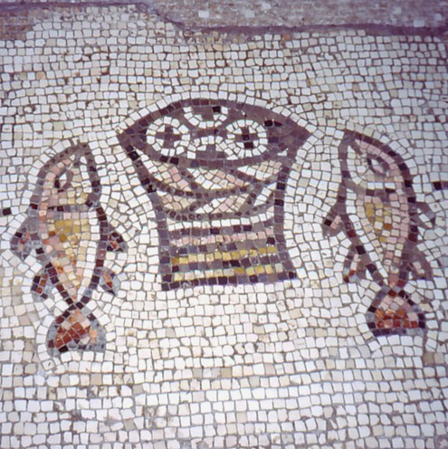
The Form of Government
The Mission of the Congregation
The congregation is the church engaged in the mission of God in its particular context. The triune God gives to the congregation all the gifts of the gospel necessary to being the Church. The congregation is the basic form of the church, but it is not of itself a sufficient form of the church.
Mosaic of Bread and Fish, Tabgha, Israel, 5th Century

Slide 31
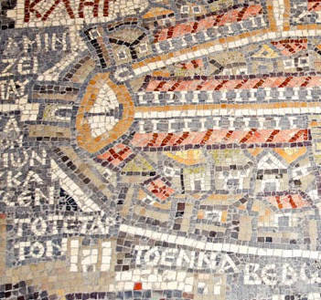
The Form of Government
Thus congregations are bound together in communion with one another, united in relationships of accountability and responsibility, contributing their strengths to the benefit of the whole, and are called, collectively, the church.
Mosaic Map of Jerusalem, Madaba, Jordan, 6th Century

Slide 32
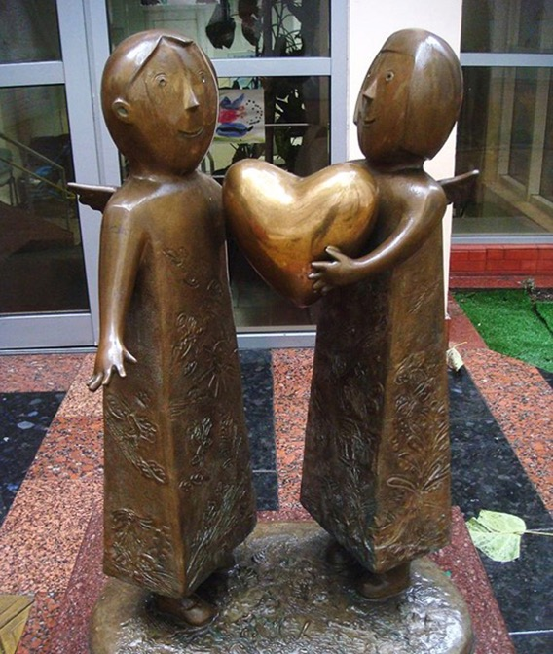
The Form of Government
Through the congregation God’s people carry out the ministries of proclamation, sharing the Sacraments, and living in covenant life with God and each other. In the life of the congregation, individual believers are equipped for the ministry of witness to the love and grace of God in and for the world.
“Heart of the World,” Mikhail Reva, 21st Century

Slide 33
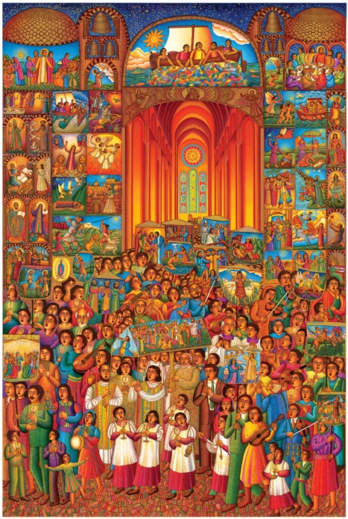
The Form of Government
The congregation reaches out to people, communities, and the world to share the good news of Jesus Christ, to gather for worship, to offer care and nurture to God’s children, to speak for social justice and righteousness, to bear witness to the truth and to the reign of God that is coming into the world. — Book of Order, G-1.0101
“The Procession,” John August Swanson, 2007

Slide 34
Questions for Discussion or Reflection
What does the statement on the “Mission of the Congregation” in Form of Government have to do with building congregational vitality?
With respect to congregational vitality and in light of the Confessions, how does the Form of Government inform the identity and mission of the church?
How are we called to build congregational vitality through the governance of the church?

Slide 35
The Directory for Worship
The Directory for Worship presents the denomination’s theology and practice of worship, with an understanding of worship that includes service to God and neighbor.
This presentation highlights excerpts from the Directory for Worship pertaining to the work of building congregational vitality.

Slide 36
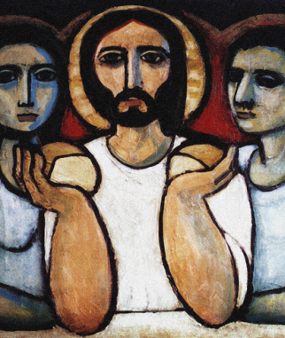
The Directory for Worship
Word and Sacrament
In Christian worship Jesus Christ is truly present and active among us, by the power of the Holy Spirit, through the gifts of Word and Sacrament. Wherever the Scriptures are read and proclaimed and the Sacraments of Baptism and the Lord’s Supper are celebrated, the Church bears witness to Jesus Christ, the living Word, and proclaims the mystery of faith.
“Breaking Bread,” Cerezo Barredo, 20th Century

Slide 37
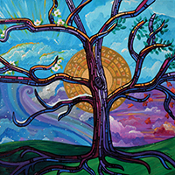
The Directory for Worship
Through these means of grace, God imparts and sustains our faith, orders our common life, and transforms the world. Through these same acts of worship, we share in the life of the Spirit, are united to Jesus Christ, and give glory to God. —Book of Order, W-1.0106
“Time of the Season,” Lauren Wright Pittman, 2016

Slide 38
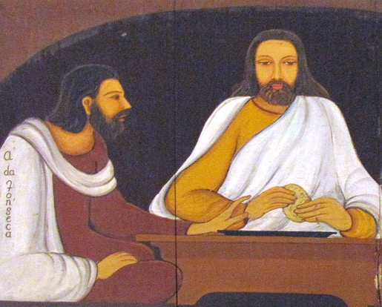
The Directory for Worship
Worship and the Church
God’s gifts of Word and Sacrament establish and equip the Church as the body of Christ in the world. The mission of the one, holy, catholic, and apostolic Church flows from Baptism, is nourished at Lord’s Supper, and serves to proclaim the good news of Jesus Christ to all.
“Breaking Bread,” Angelo da Fonseca, 20th Century

Slide 39
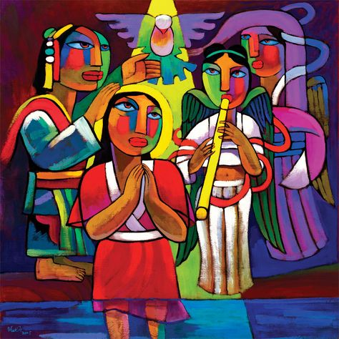
The Directory for Worship
In the same way, the Church’s ministry emerges from the font, arises from the table, and takes its shape from the Word of the Lord. Therefore the worship of the triune God is the center of our common life and our primary way of witness to the faith, hope, and love we have in Jesus Christ.
“Baptism of Jesus,” He Qi, 2013

Slide 40
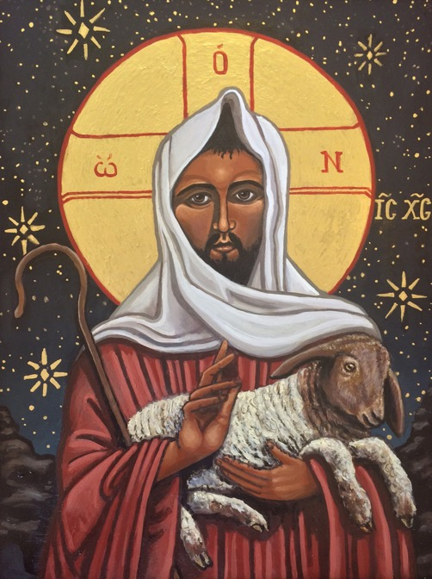
The Directory for Worship
To be a Christian is to worship Jesus Christ as Savior and Lord. To be a member of Christ’s body, the Church, is to share through Word and Sacrament in the grace of the Lord Jesus Christ, the love of God, and the communion of the Holy Spirit. —Book of Order, W-1.0107
”Good Shepherd,” Kelly Latimore, 2019

Slide 41
Questions for Discussion or Reflection
What do the Directory for Worship passages on “Word and Sacrament” and “Worship and the Church” have to say about building congregational vitality?
With respect to congregational vitality and in light of the Confessions, how does the Directory for Worship inform the identity and mission of the church?
How are we called to build congregational vitality in worship?

Slide 42
Additional Resources
For more information on the Matthew 25 vision of the Presbyterian Church (U.S.A.), including resources for building congregational vitality, visit pcusa.org/Matthew25.

