Slide 1
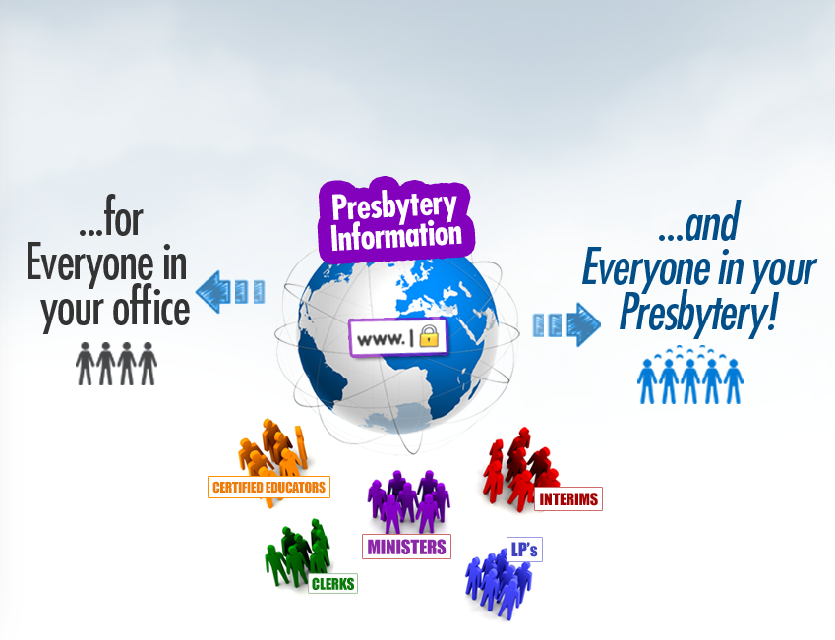

What it is
Provide useful, current information
for everyone... from anywhere... anytime*
The need
Our approach
The results
Why now?
Get |cbase|
*With proper
authorization
and security
of course

Slide 2
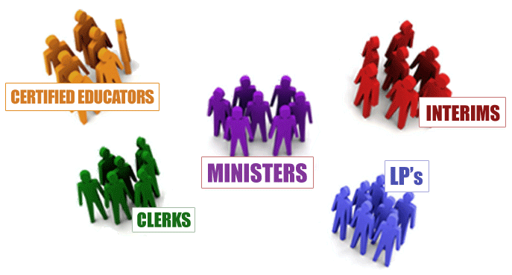
What it is
The need
Our approach
The results
Why now?
Get |cbase|

Slide 3
What it is
A rich context...
The need
Our approach
The results
Why now?
Get |cbase|

Slide 4
What it is
A rich context...
The need
Our approach
The results
Why now?
Get |cbase|
A history over time...

Slide 5
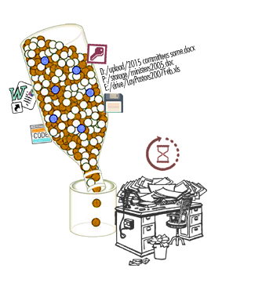
What it is
The need
Our approach
The results
Why now?
Get |cbase|

Slide 6
What it is
The Bottleneck Problem
The need
Our approach
The results
Why now?
Get |cbase|

Slide 7
What it is
The Bottleneck Problem
The need
Only one person knows how
Our approach
The results
Why now?
Get |cbase|

Slide 8
What it is
The Bottleneck Problem
The need
Only one person knows how
Scattered data
Our approach
The results
Why now?
Get |cbase|

Slide 9
What it is
The Bottleneck Problem
The need
Only one person knows how
Scattered data
Hours on tedious manual work
Our approach
The results
Why now?
Get |cbase|

Slide 10
What it is
The Bottleneck Problem
The need
Only one person knows how
Scattered data
Hours on tedious manual work
1 change, 7 places
Our approach
The results
Why now?
Get |cbase|

Slide 11
What it is
The Bottleneck Problem
The need
Only one person knows how
Scattered data
Hours on tedious manual work
1 change, 7 places
Always out-of-date constant “catch-up”
Our approach
The results
Why now?
Get |cbase|

Slide 12
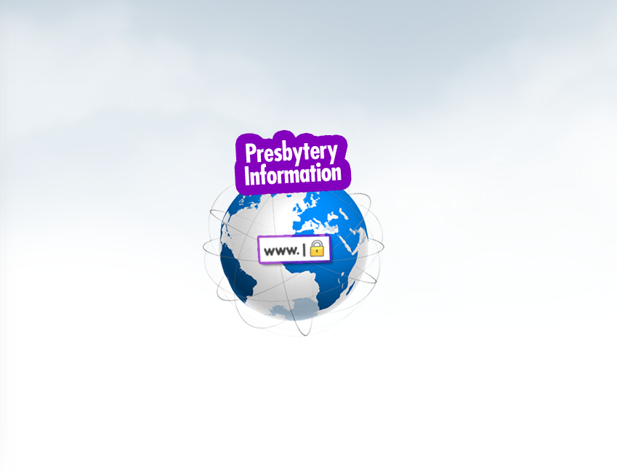
What it is
|cbase|
Keep all the info in one central place
The need
Our approach
The results
Why now?
Get |cbase|

Slide 13
What it is
Eliminate
technical and publishing hurdles
The need
Our approach
The results
Why now?
Get |cbase|

Slide 14
What it is
Design entire framework around inevitable fact
that people have
multiple, concurrent
past/present/future
roles
The need
Our approach
The results
Why now?
Get |cbase|

Slide 15
What it is
A closer look at the results
The need
Our approach
The results
Why now?
Get |cbase|

Slide 16
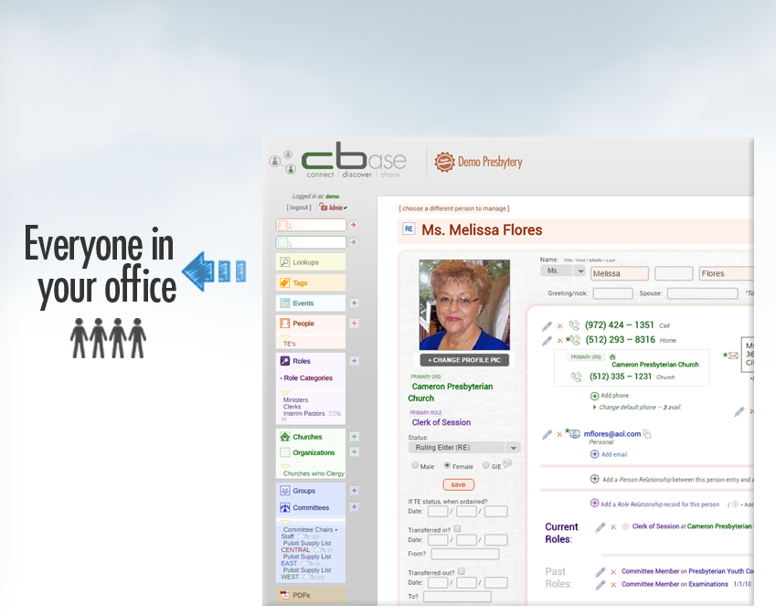
What it is
The |cbase| Admin login
The need
Our approach
The results
Why now?
Get |cbase|

Slide 17
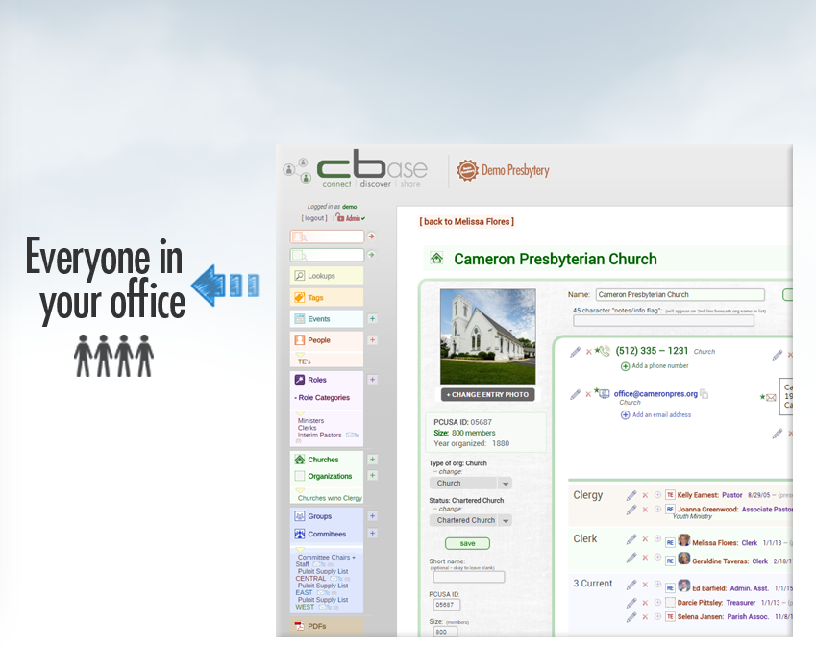
What it is
The |cbase| Admin login
The need
Our approach
The results
Why now?
Get |cbase|

Slide 18
What it is
The |cbase| Admin login
The need
Our approach
The results
Why now?
Get |cbase|

Slide 19
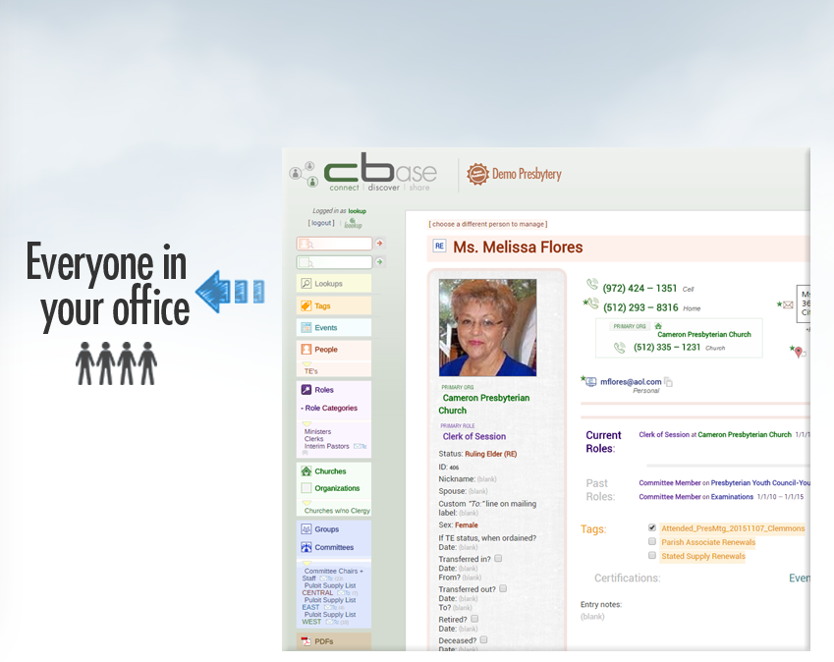
What it is
The |cbase| Lookup login
The need
Our approach
The results
Why now?
Get |cbase|

Slide 20
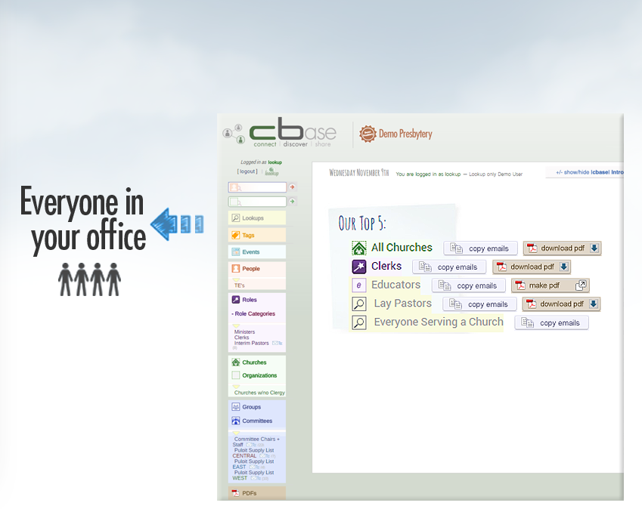
What it is
The |cbase| Lookup login
The need
Our approach
The results
Why now?
Get |cbase|

Slide 21
What it is
|cbase|
Keep all the info in one central place
The need
Our approach
The results
Why now?
Get |cbase|

Slide 22
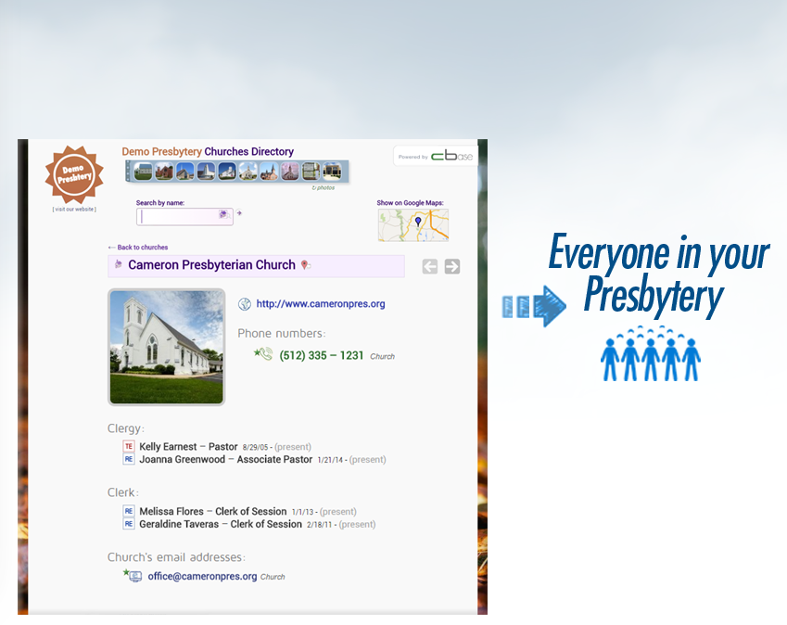
What it is
|cbase| Online Churches Directory
The need
Our approach
The results
Why now?
Get |cbase|

Slide 23
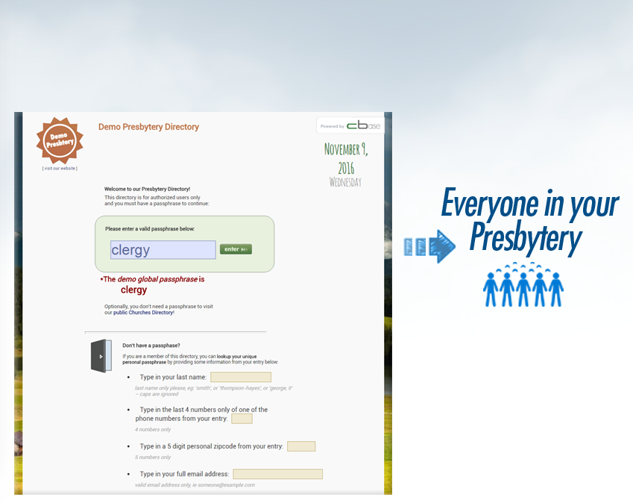
What it is
|cbase| Online Presbytery Directory
The need
Our approach
The results
Why now?
Get |cbase|

Slide 24
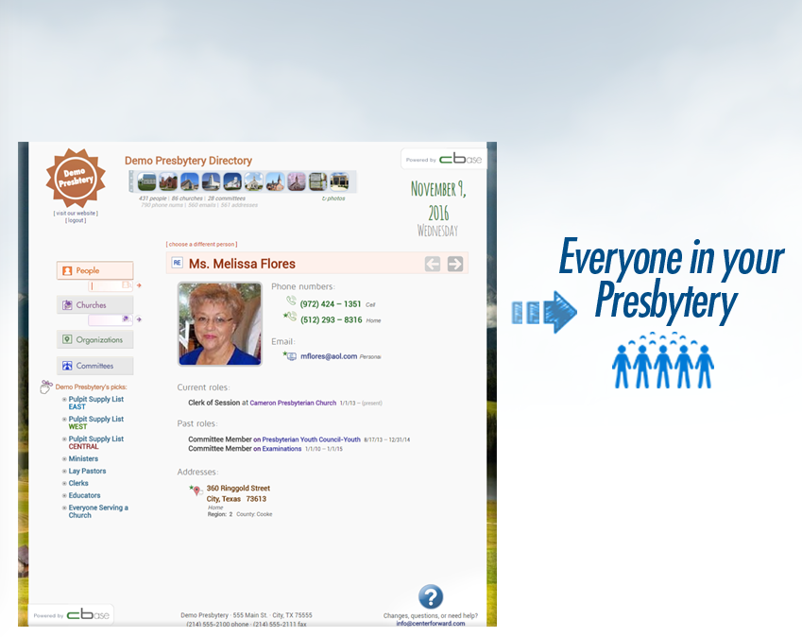
What it is
|cbase| Online Presbytery Directory
The need
Our approach
The results
Why now?
Get |cbase|

Slide 25
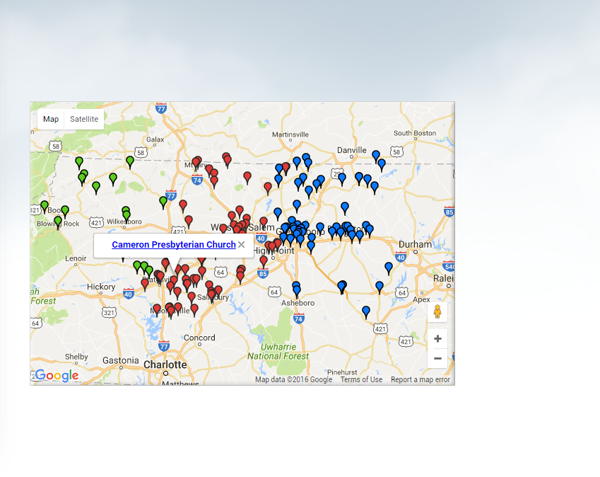
What it is
|cbase| Online Presbytery Directory
The need
Our approach
The results
Why now?
Get |cbase|

Slide 26
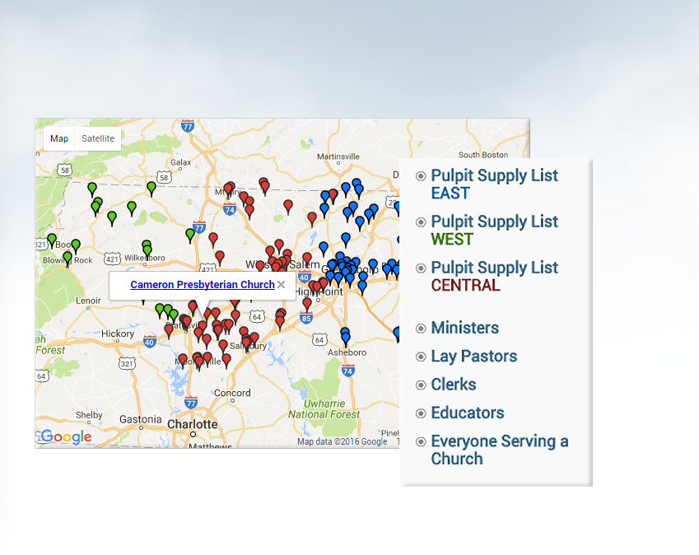
What it is
|cbase| Online Presbytery Directory
The need
Our approach
The results
Why now?
Get |cbase|

Slide 27
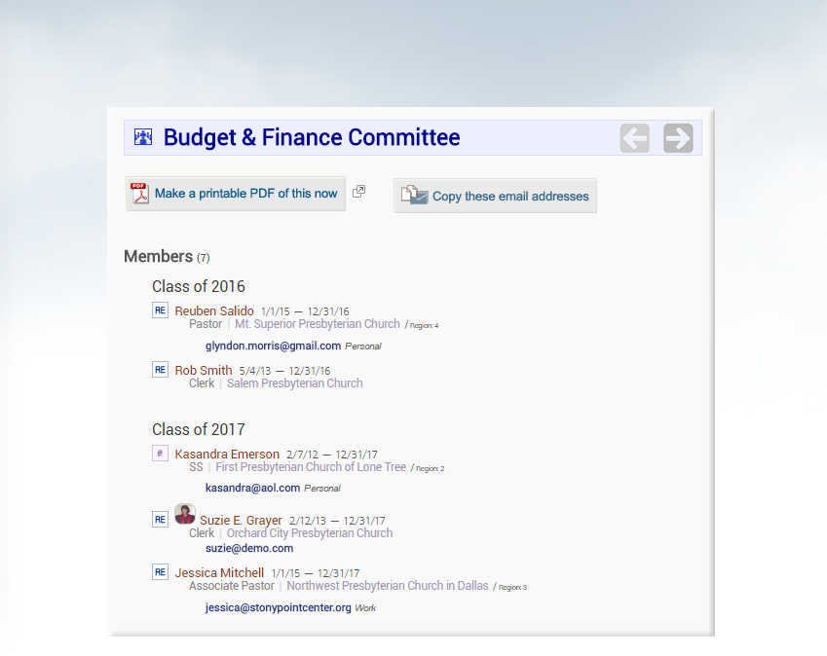
What it is
|cbase| Online Presbytery Directory
The need
Our approach
The results
Why now?
Get |cbase|

Slide 28
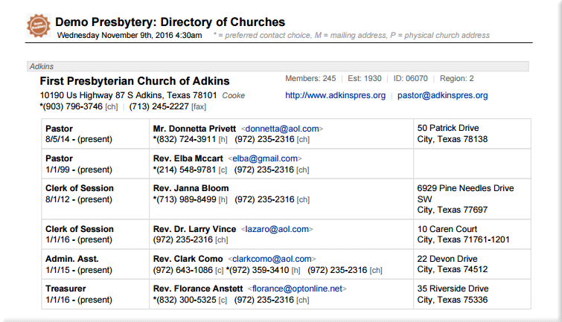
What it is
Automatic creation of all PDFs
The need
Our approach
The results
Why now?
Get |cbase|

Slide 29
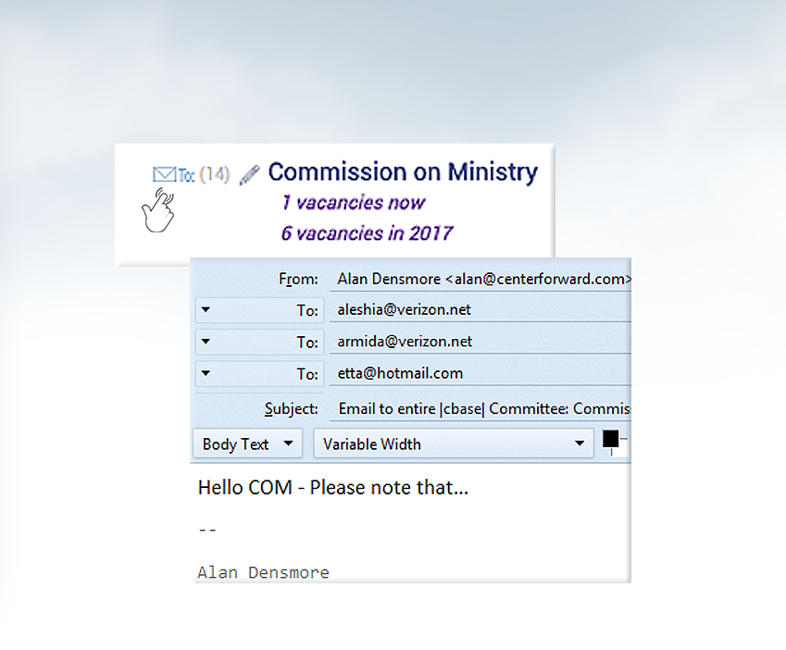
What it is
Email everyone on COM in one click
The need
Our approach
The results
Why now?
Get |cbase|

Slide 30

What it is
Why implement |cbase| now?
The need
Our approach
The results
Why now?
Get |cbase|

Slide 31
What it is
Why implement |cbase| now?
The church is a living body;
Many people in many changing roles…
The presbytery is always in “transition”
The technology and processes you employ can inform and direct times of change rather than reacting
after the fact
The need
Our approach
The results
Why now?
Get |cbase|

Slide 32
What it is
What if every effort began with convenient access to current, reliable information?
How might that make the best use of valuable, limited human resources?
How could it help to work from anywhere?
The need
Our approach
The results
Why now?
In times of transition and change,
information could be a
“Everyone, Anywhere, Anytime resource”
instead of a nagging clerical hassle
Get |cbase|

Slide 33
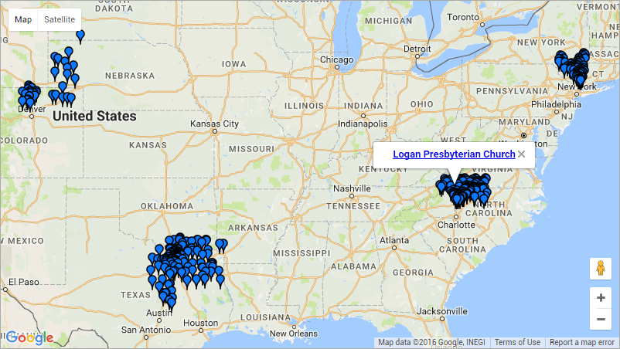
What it is
Who’s using |cbase| now?
The need
Our approach
The results
Why now?
Get |cbase|
100 committees, 500 churches,
8000 people in |cbase| today

Slide 34
What it is
Flat, Fair Pricing – online at cbase.us
The need
$349/month +
one-time $49 per church setup cost
Seamless transition (~1 month)
All websites and hosting included
No per-incident support fees
No “add-on” pricing or hidden costs
Regular upgrades included
Known budgetable annual cost for full premium support (See reviews)
Our approach
The results
Why now?
Get |cbase|

Slide 35
What it is
Contact Alan Densmore | visit cbase.us
(214) 280-4226 alan@centerforward.com
The need
Immediately upon installation:
Our approach
All data/info “cleaned up,” all in one place
Better serve and connect people & churches
Start capturing a history and building context
The results
Why now?
|cbase|’s real potential:
Get |cbase|
Transform how your presbytery functions
Create strategic “people groups” to best
navigate and direct transition
Experience information in the “present-forward”
rather than playing catch-up from behind

